Slide 1


2021 ABA Progeny Test
Loin Chop Pictures

Slide 2
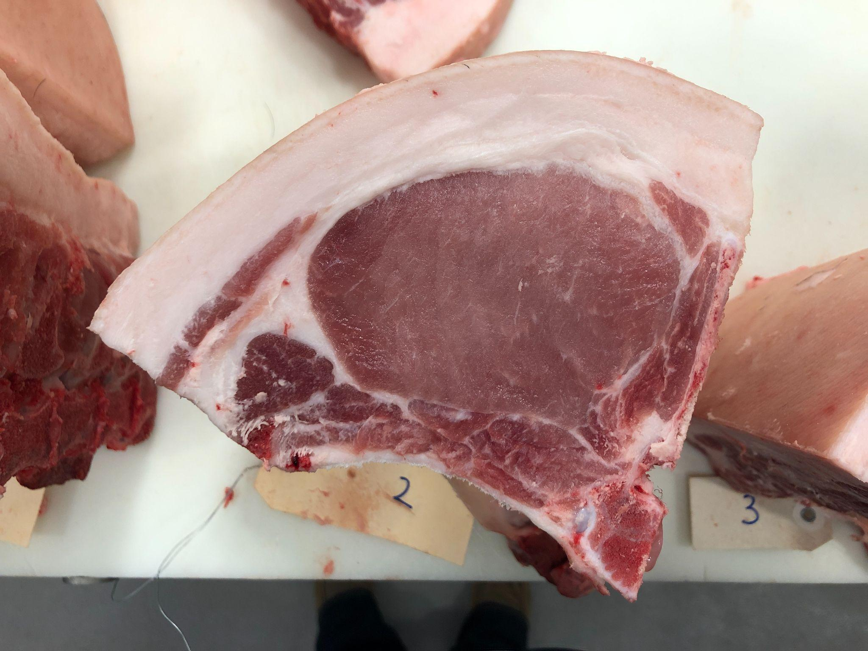
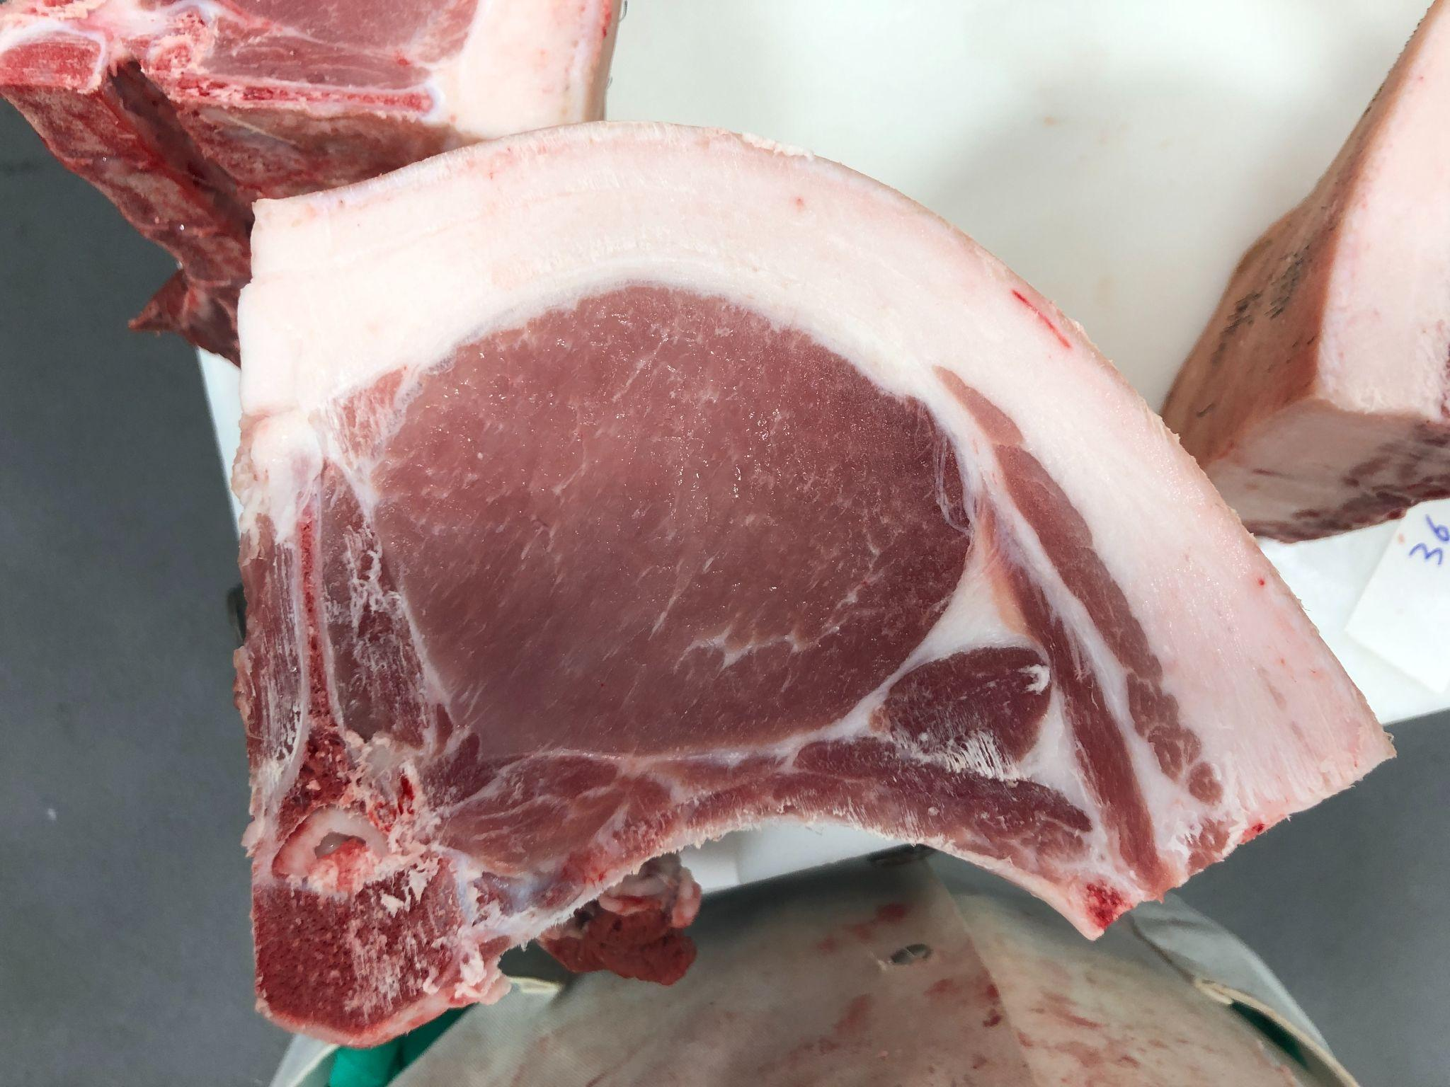
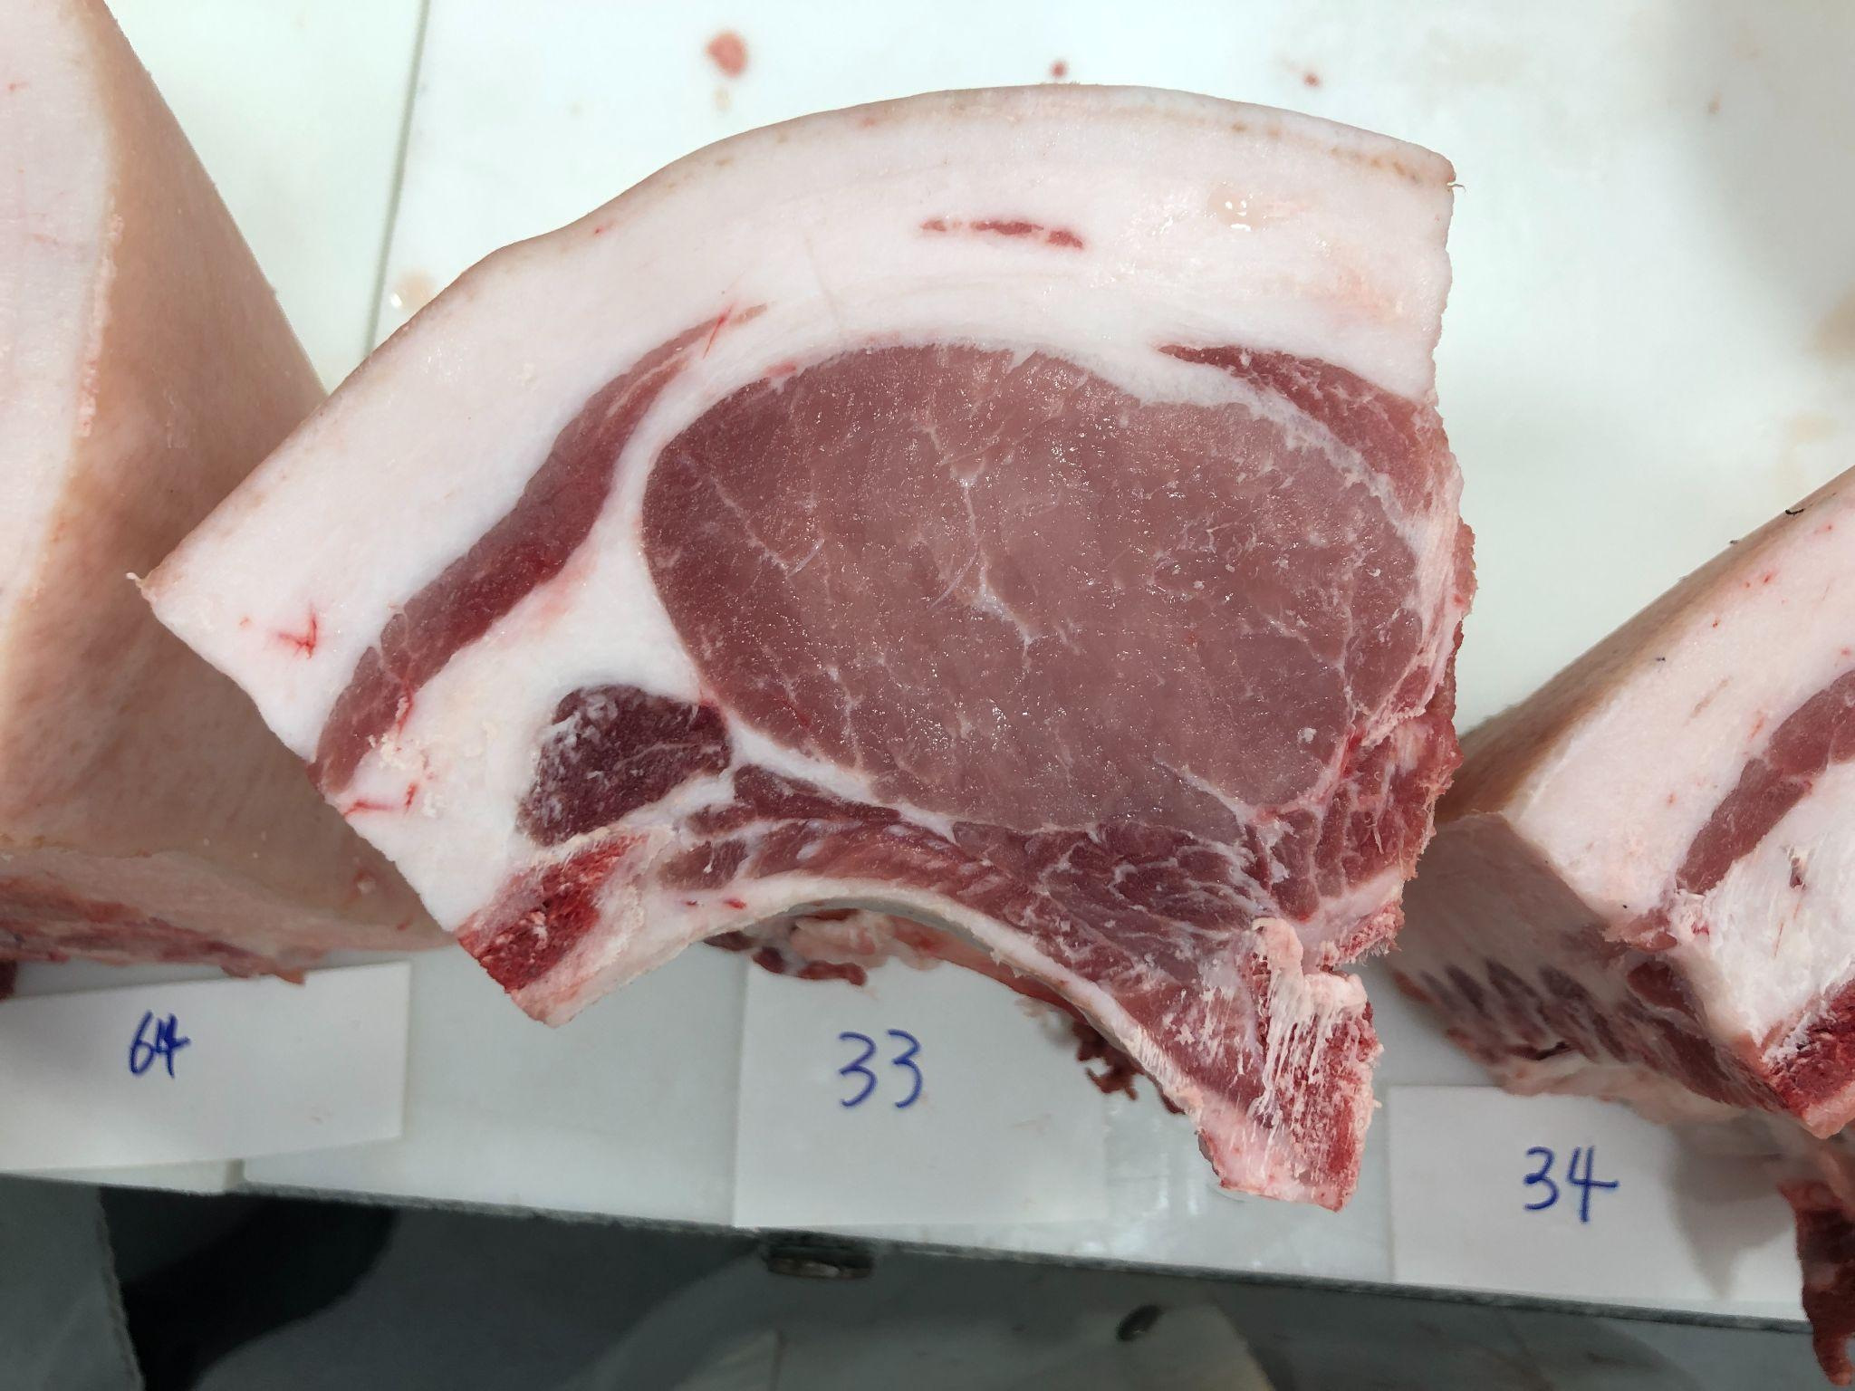
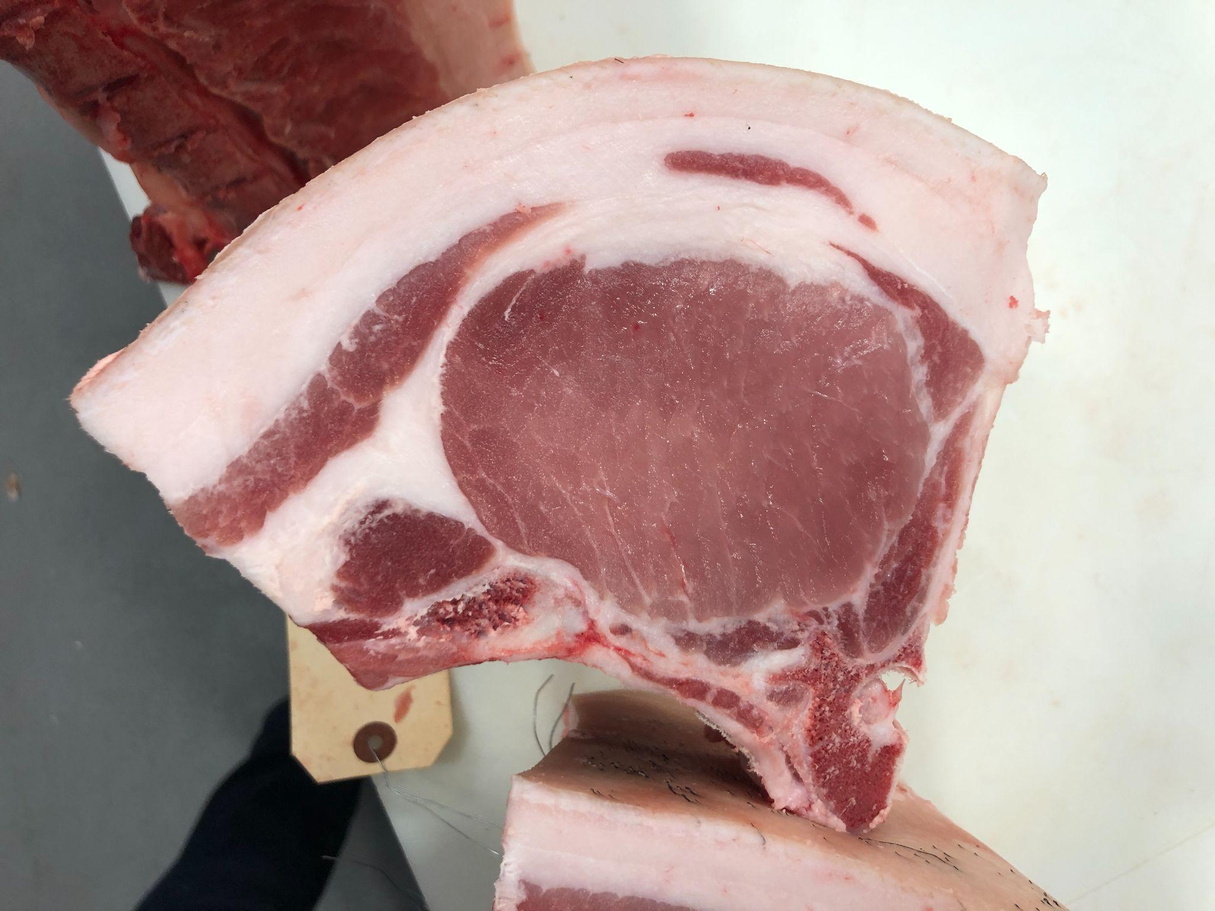
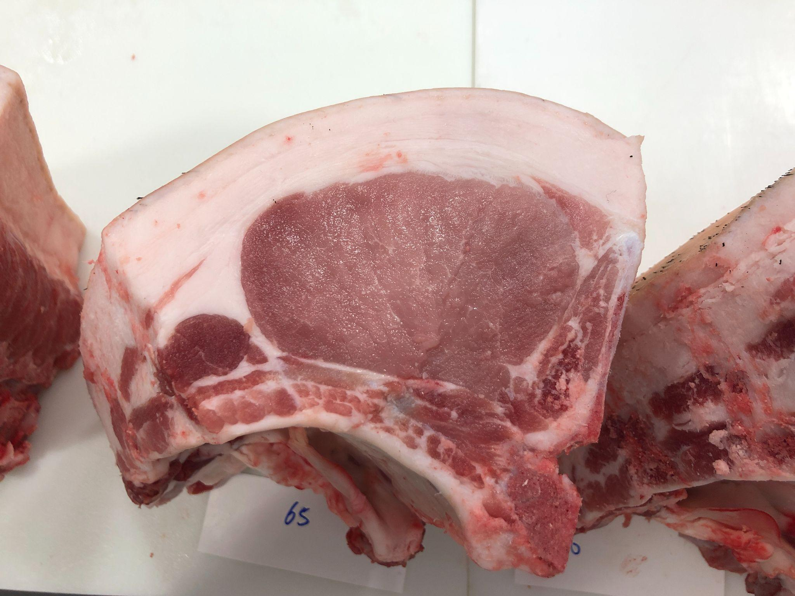
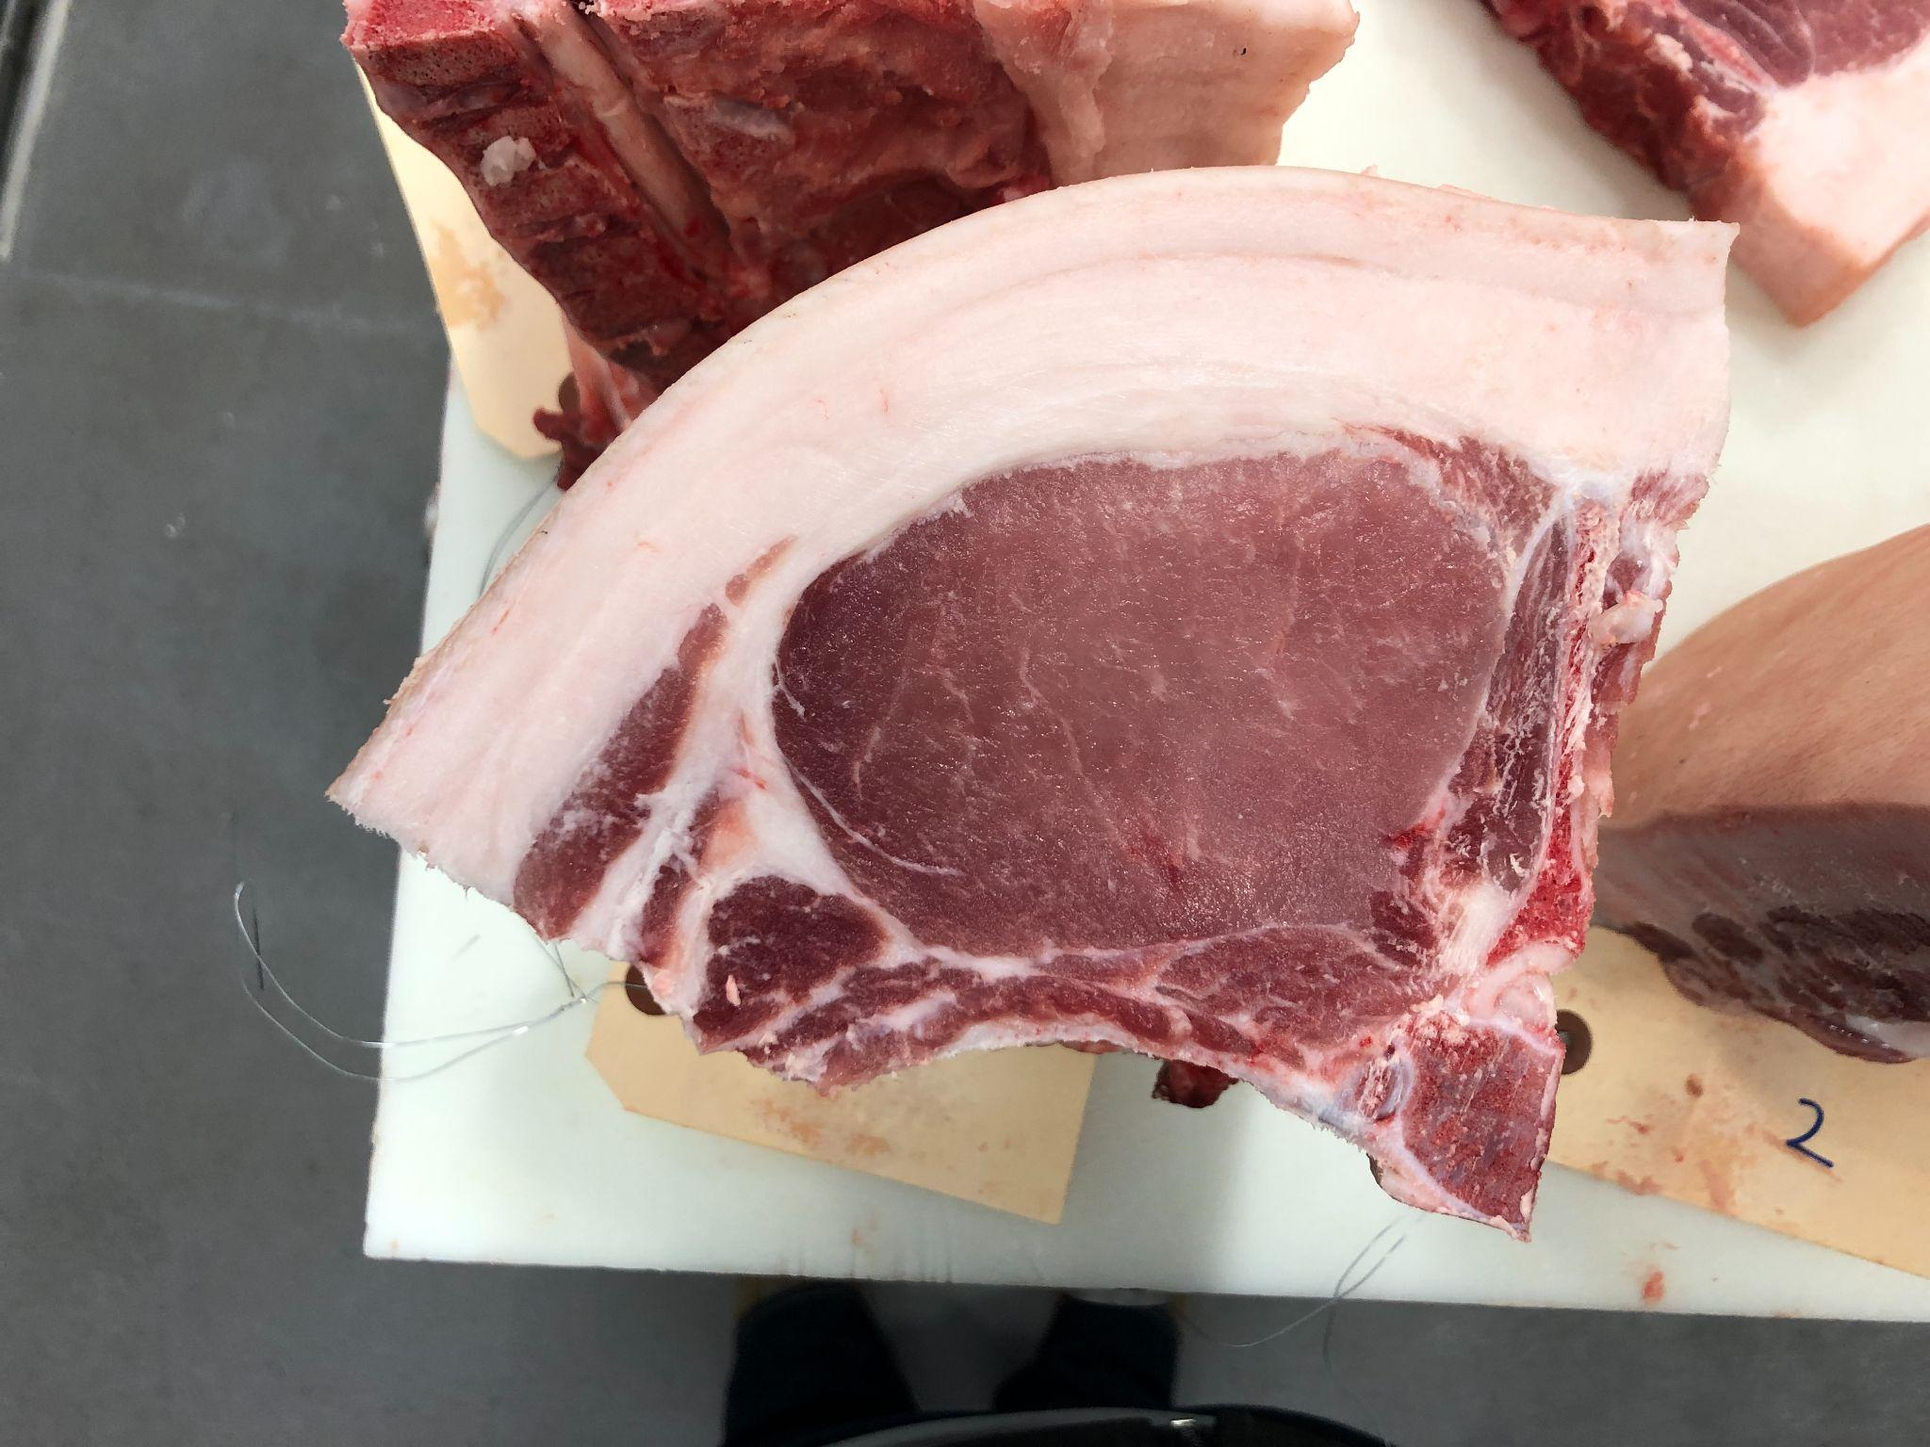
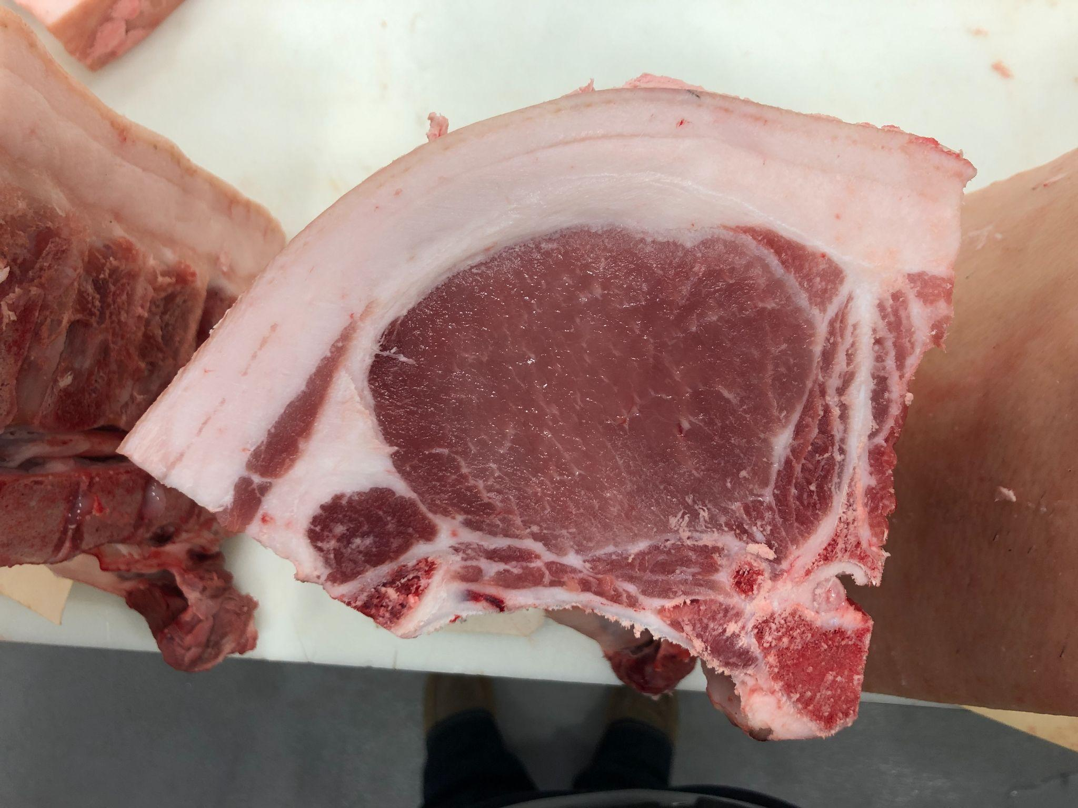
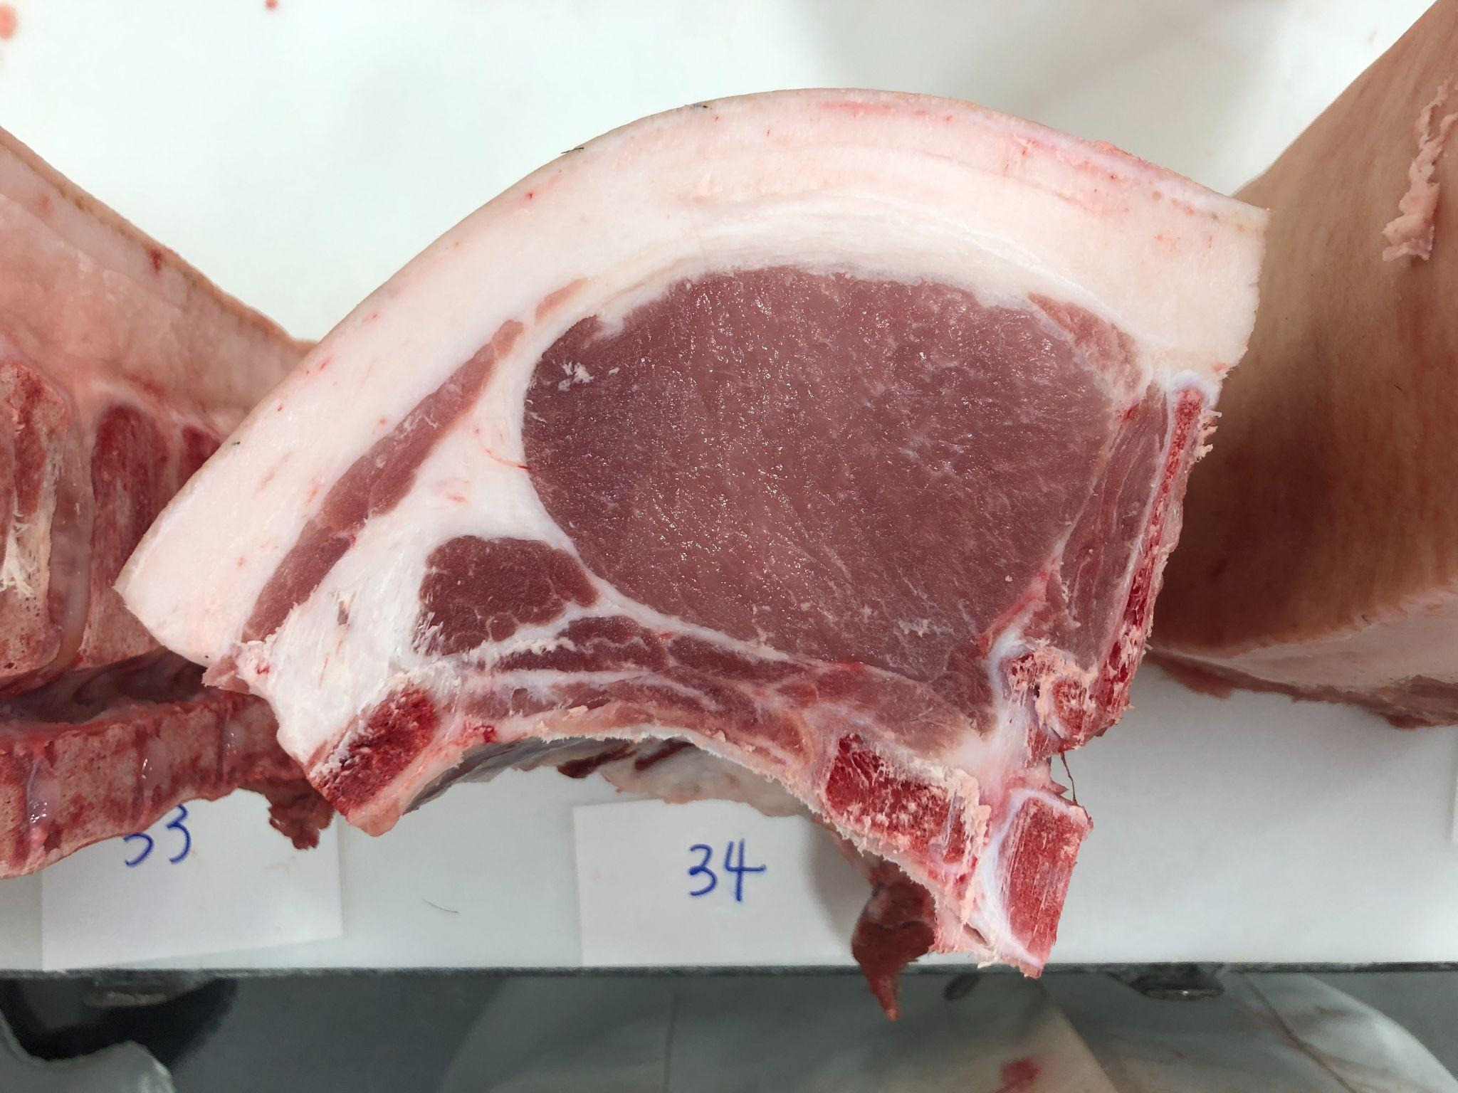
Pen 1: FKBO BELT LOADER 77-1 BY FLY’N K BERKSHIRES
8
9
12
13
14
15
19
21

Slide 3
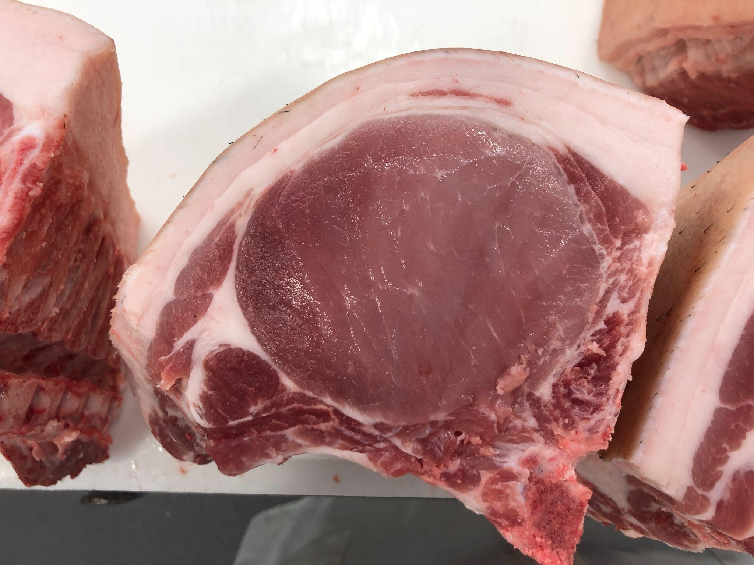
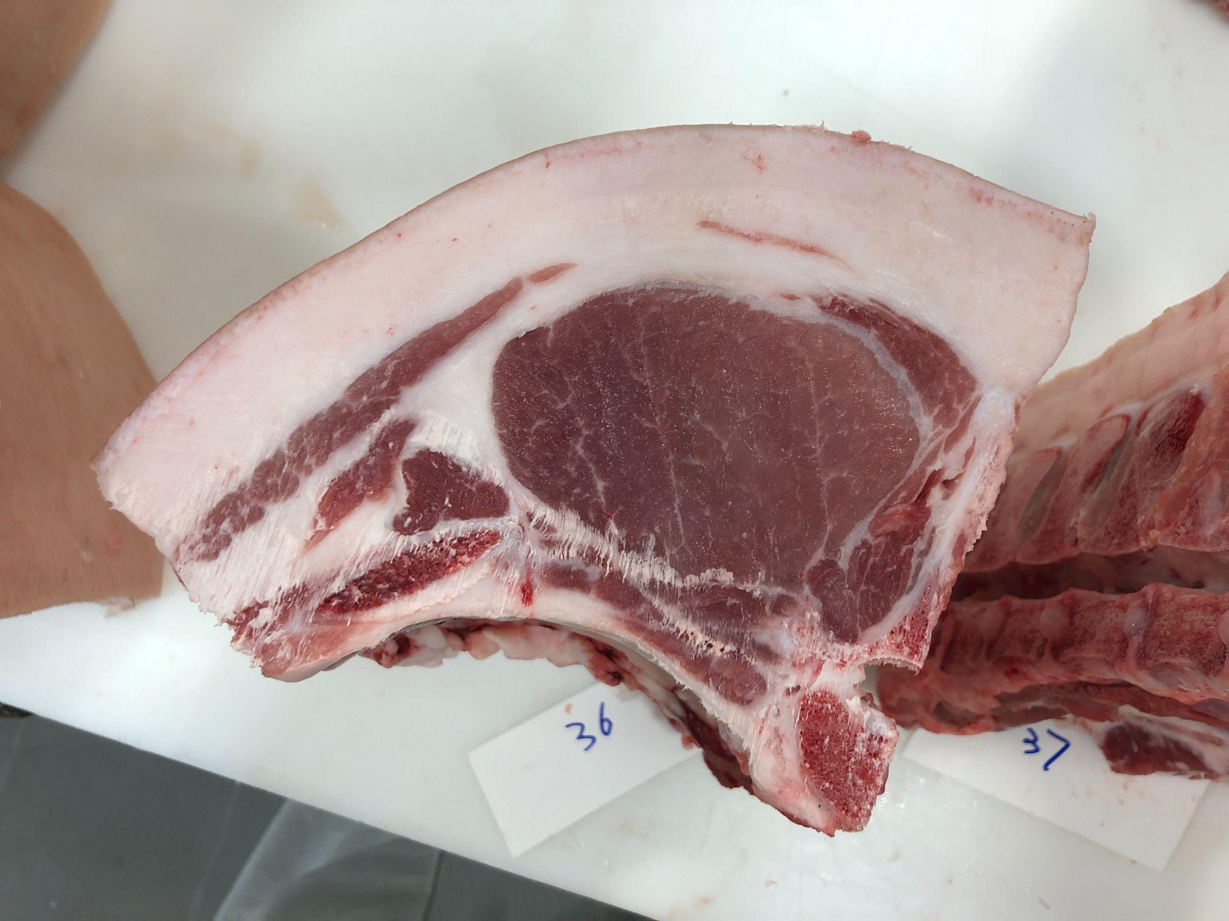
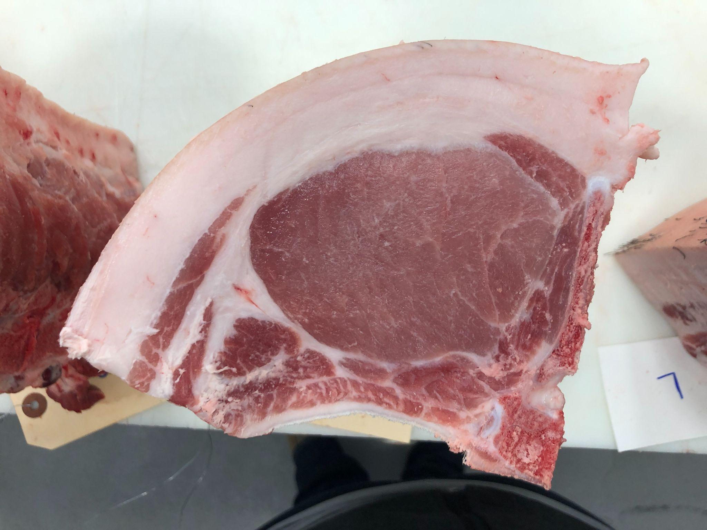
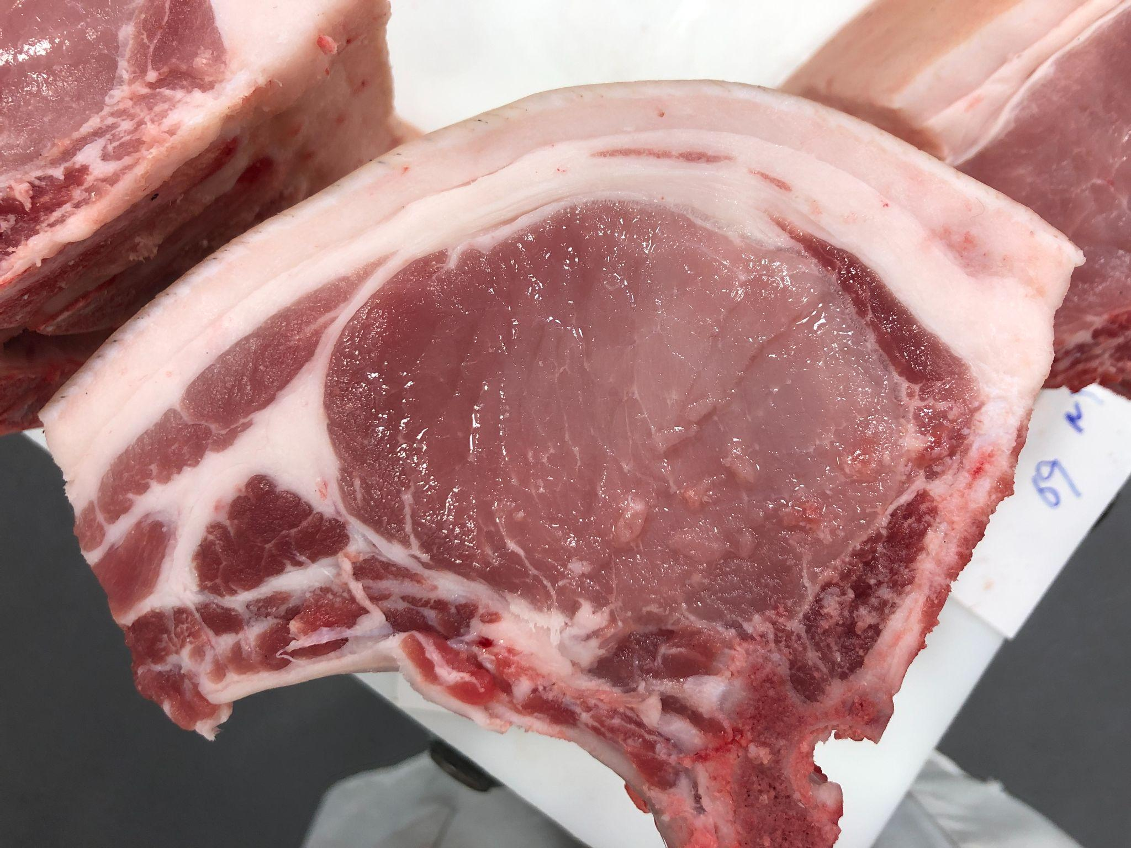
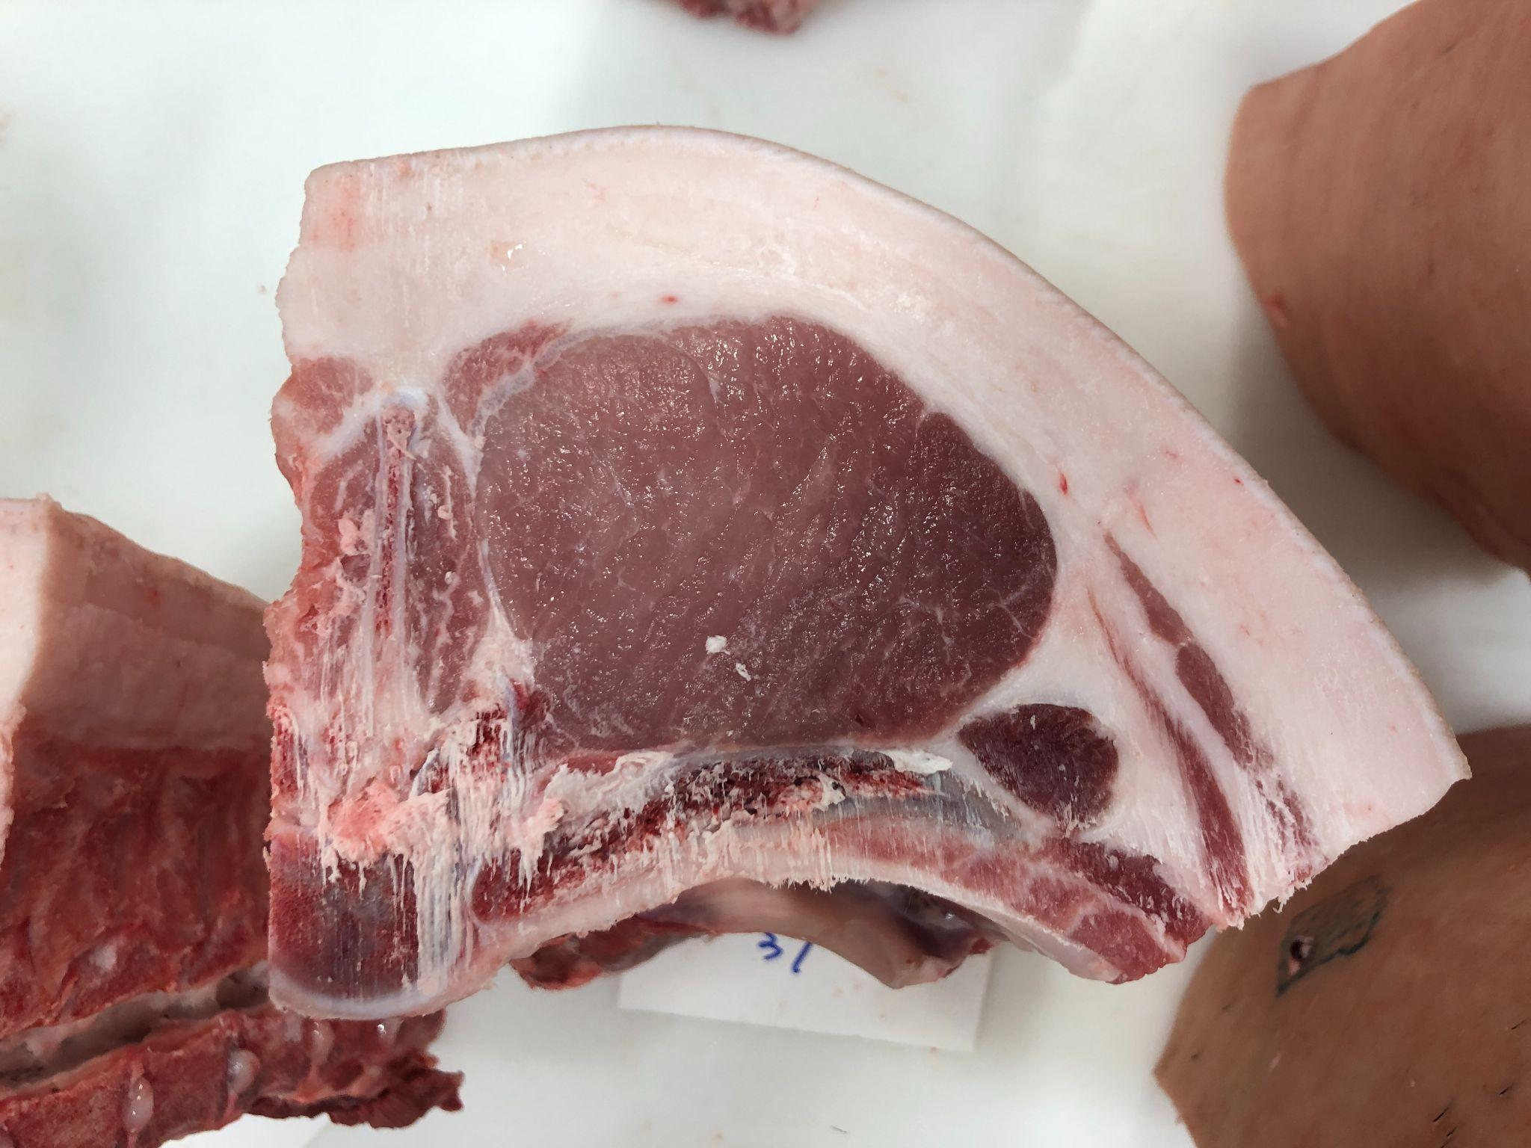
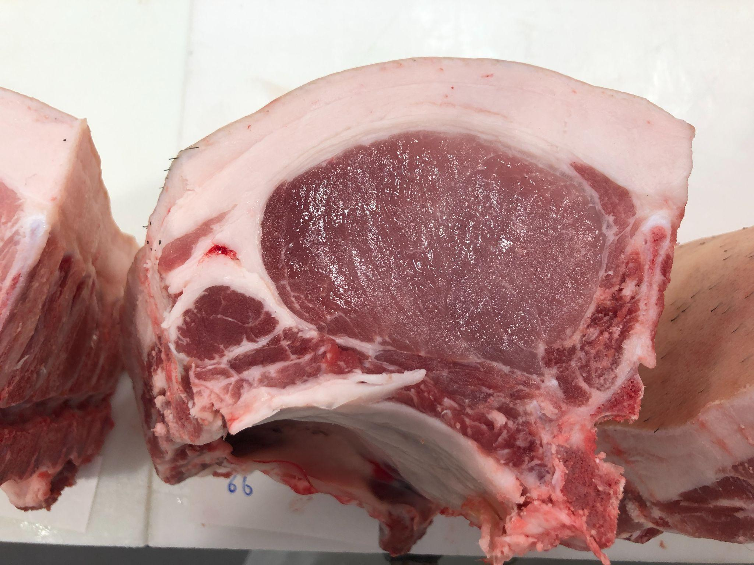
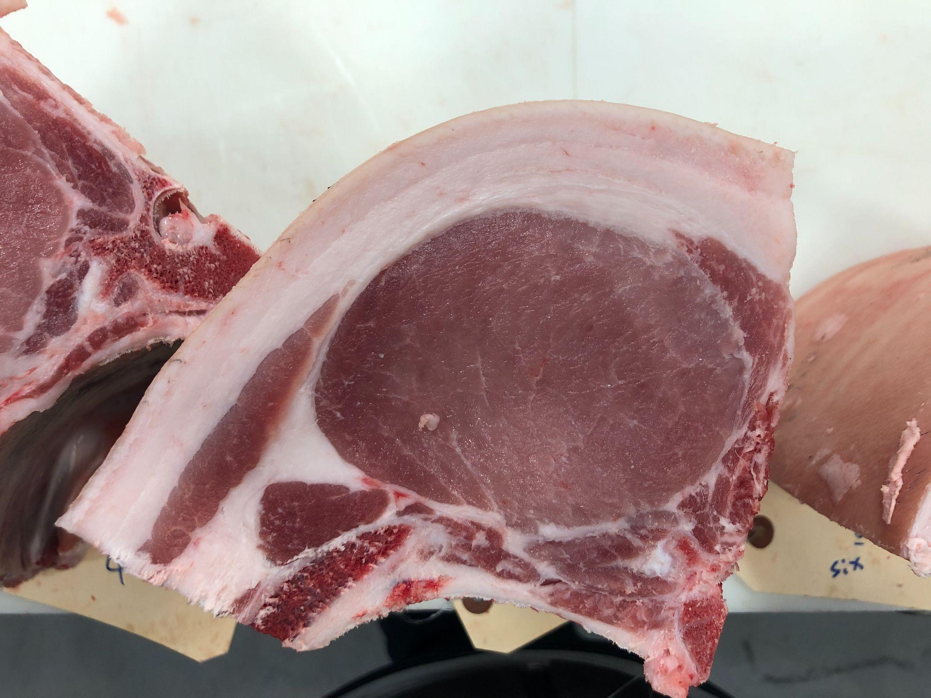
Pen 2: AJC8 Diamond Lad 5-4 BY AJC BERKSHIRES
2
3
4
5
6
7
8

Slide 4
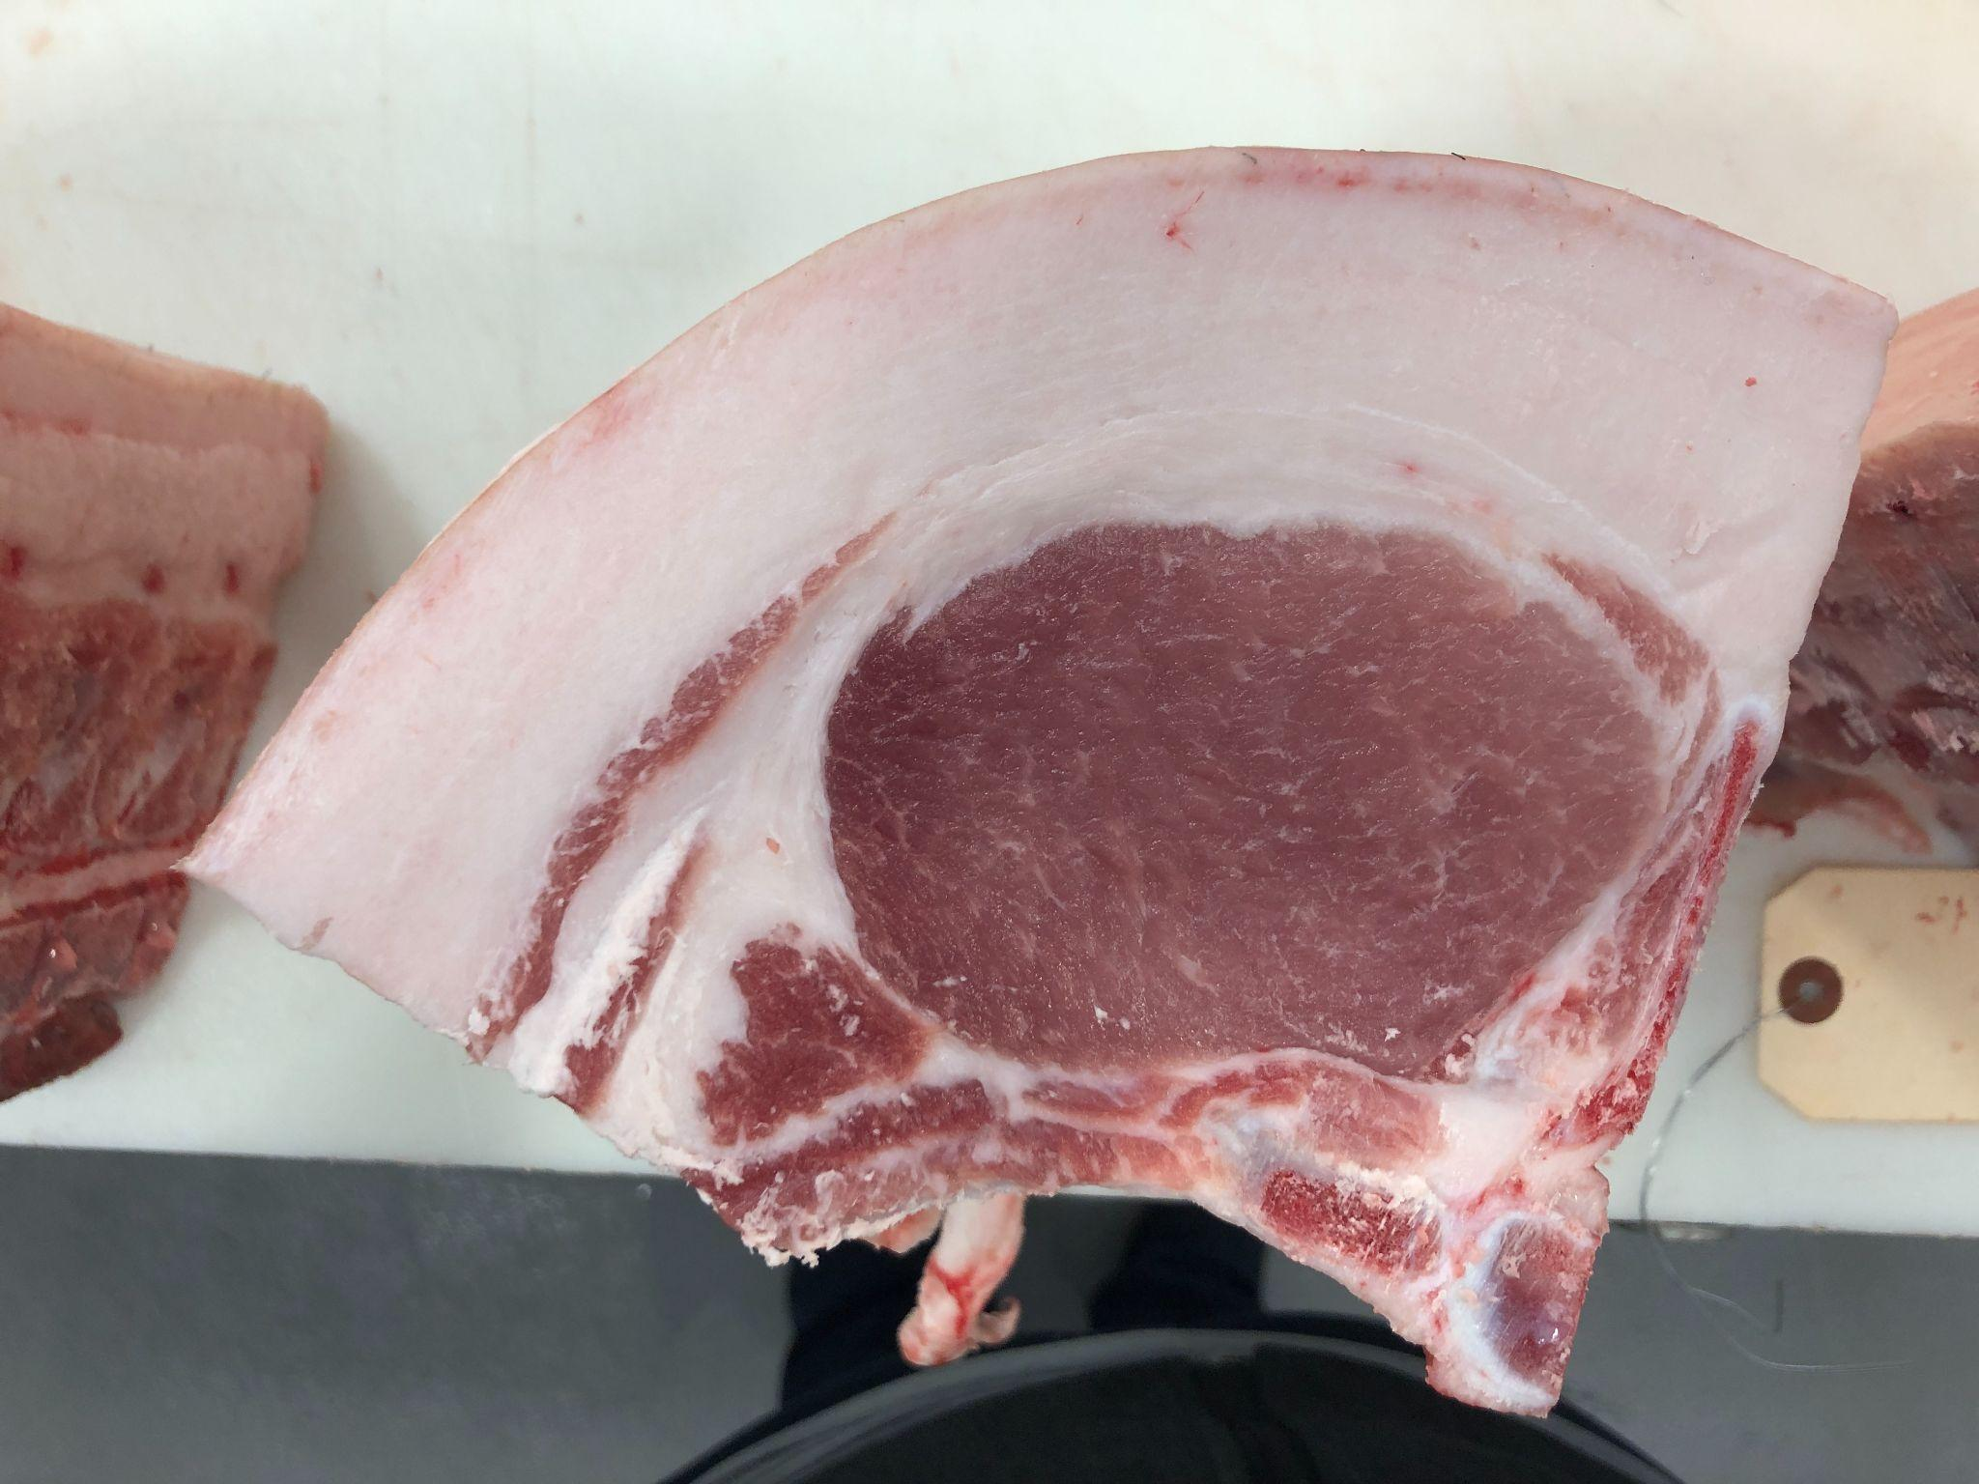
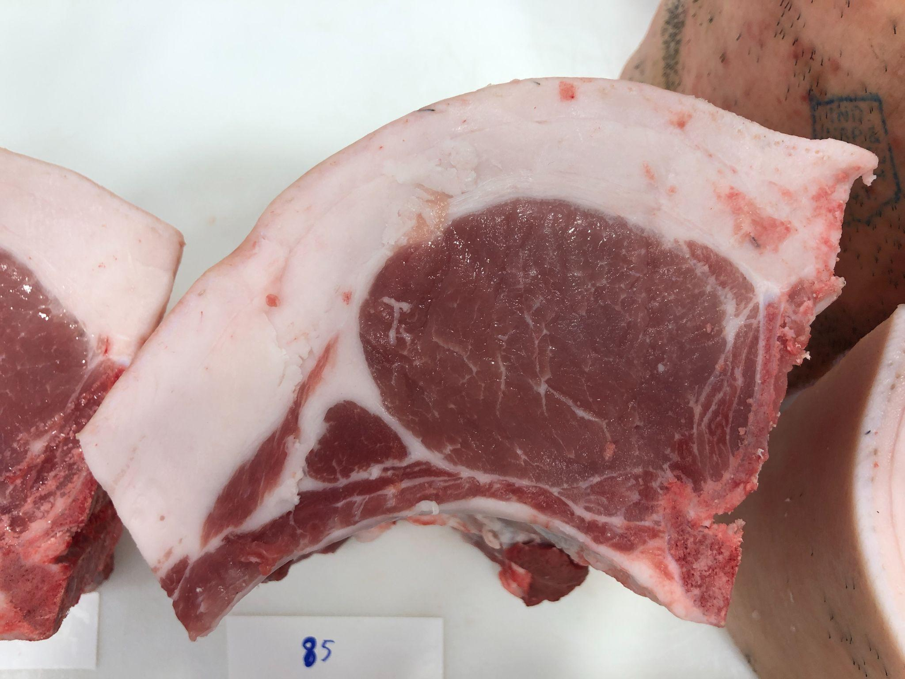
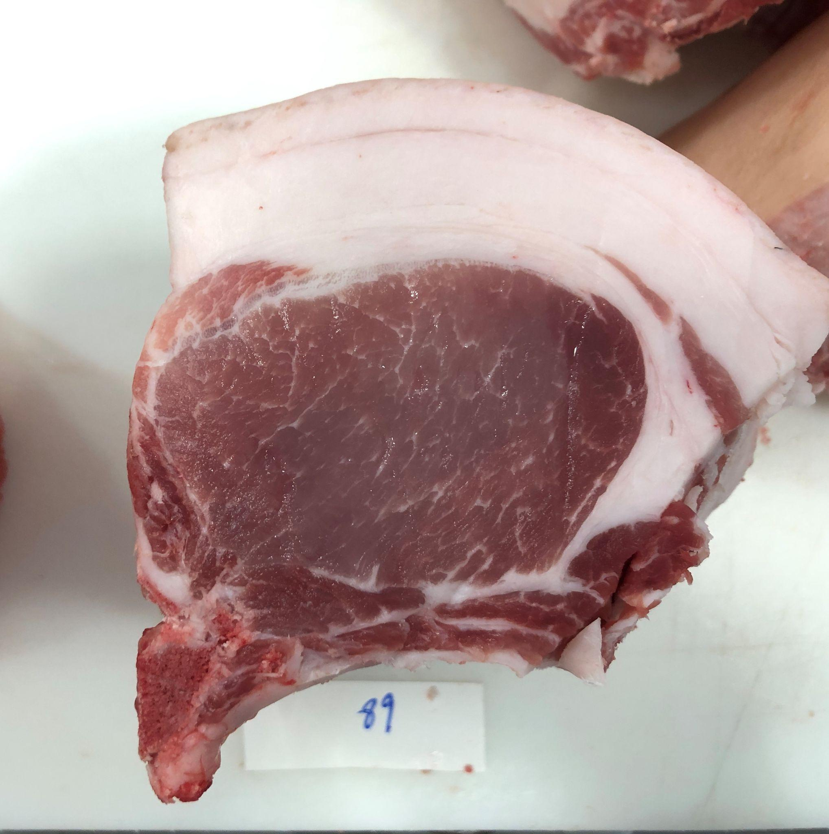
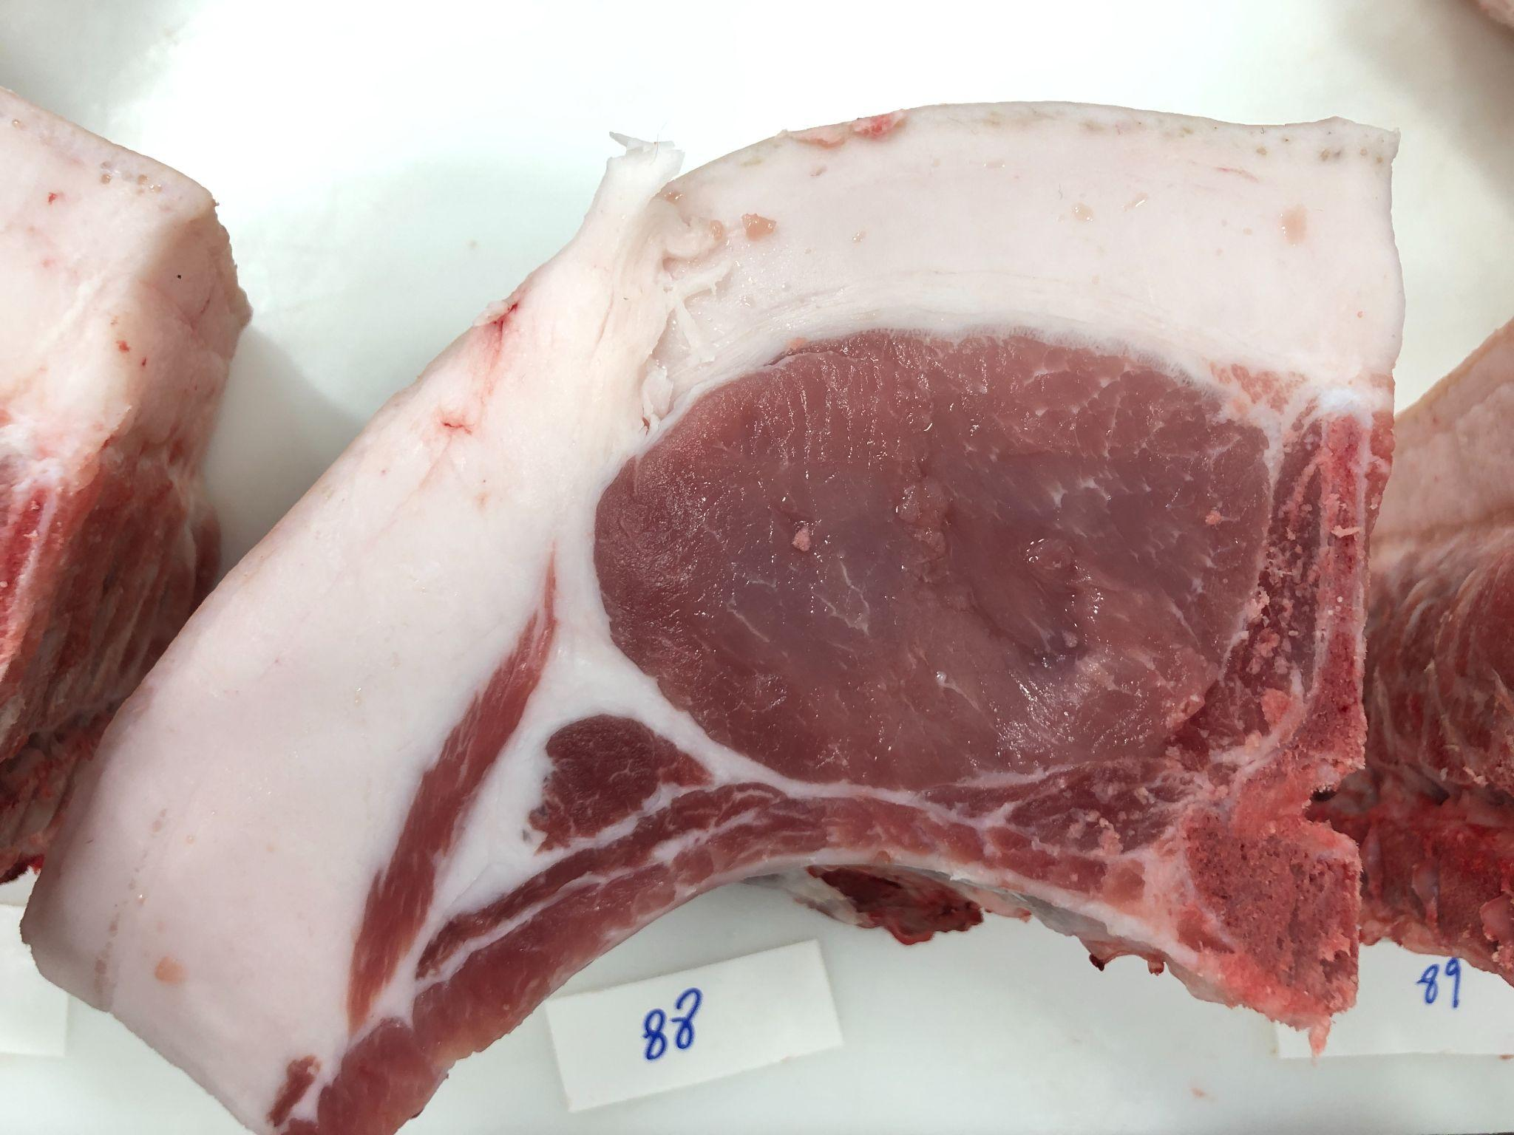
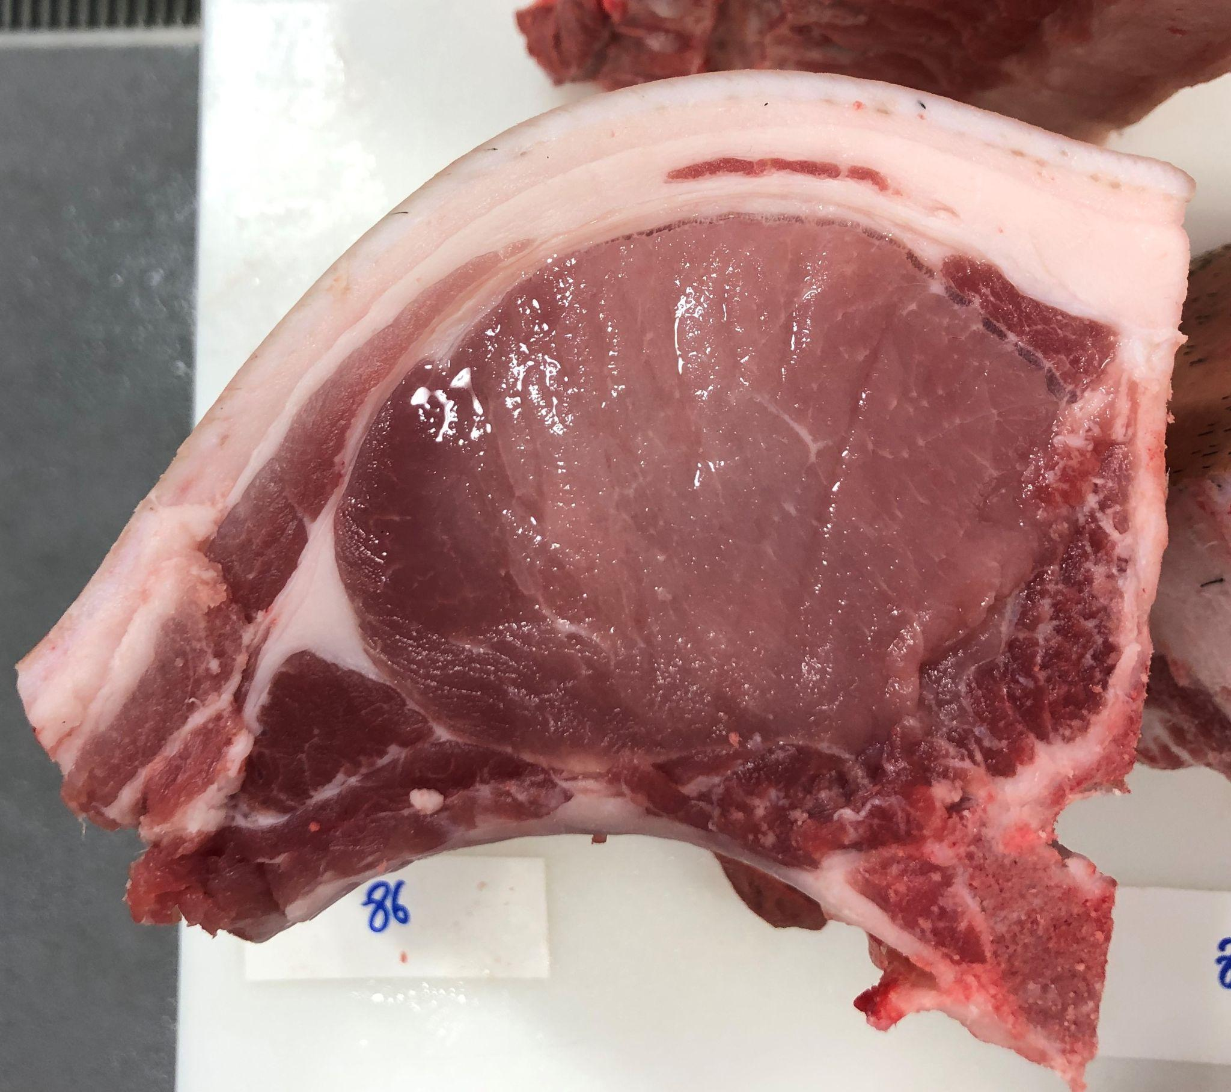
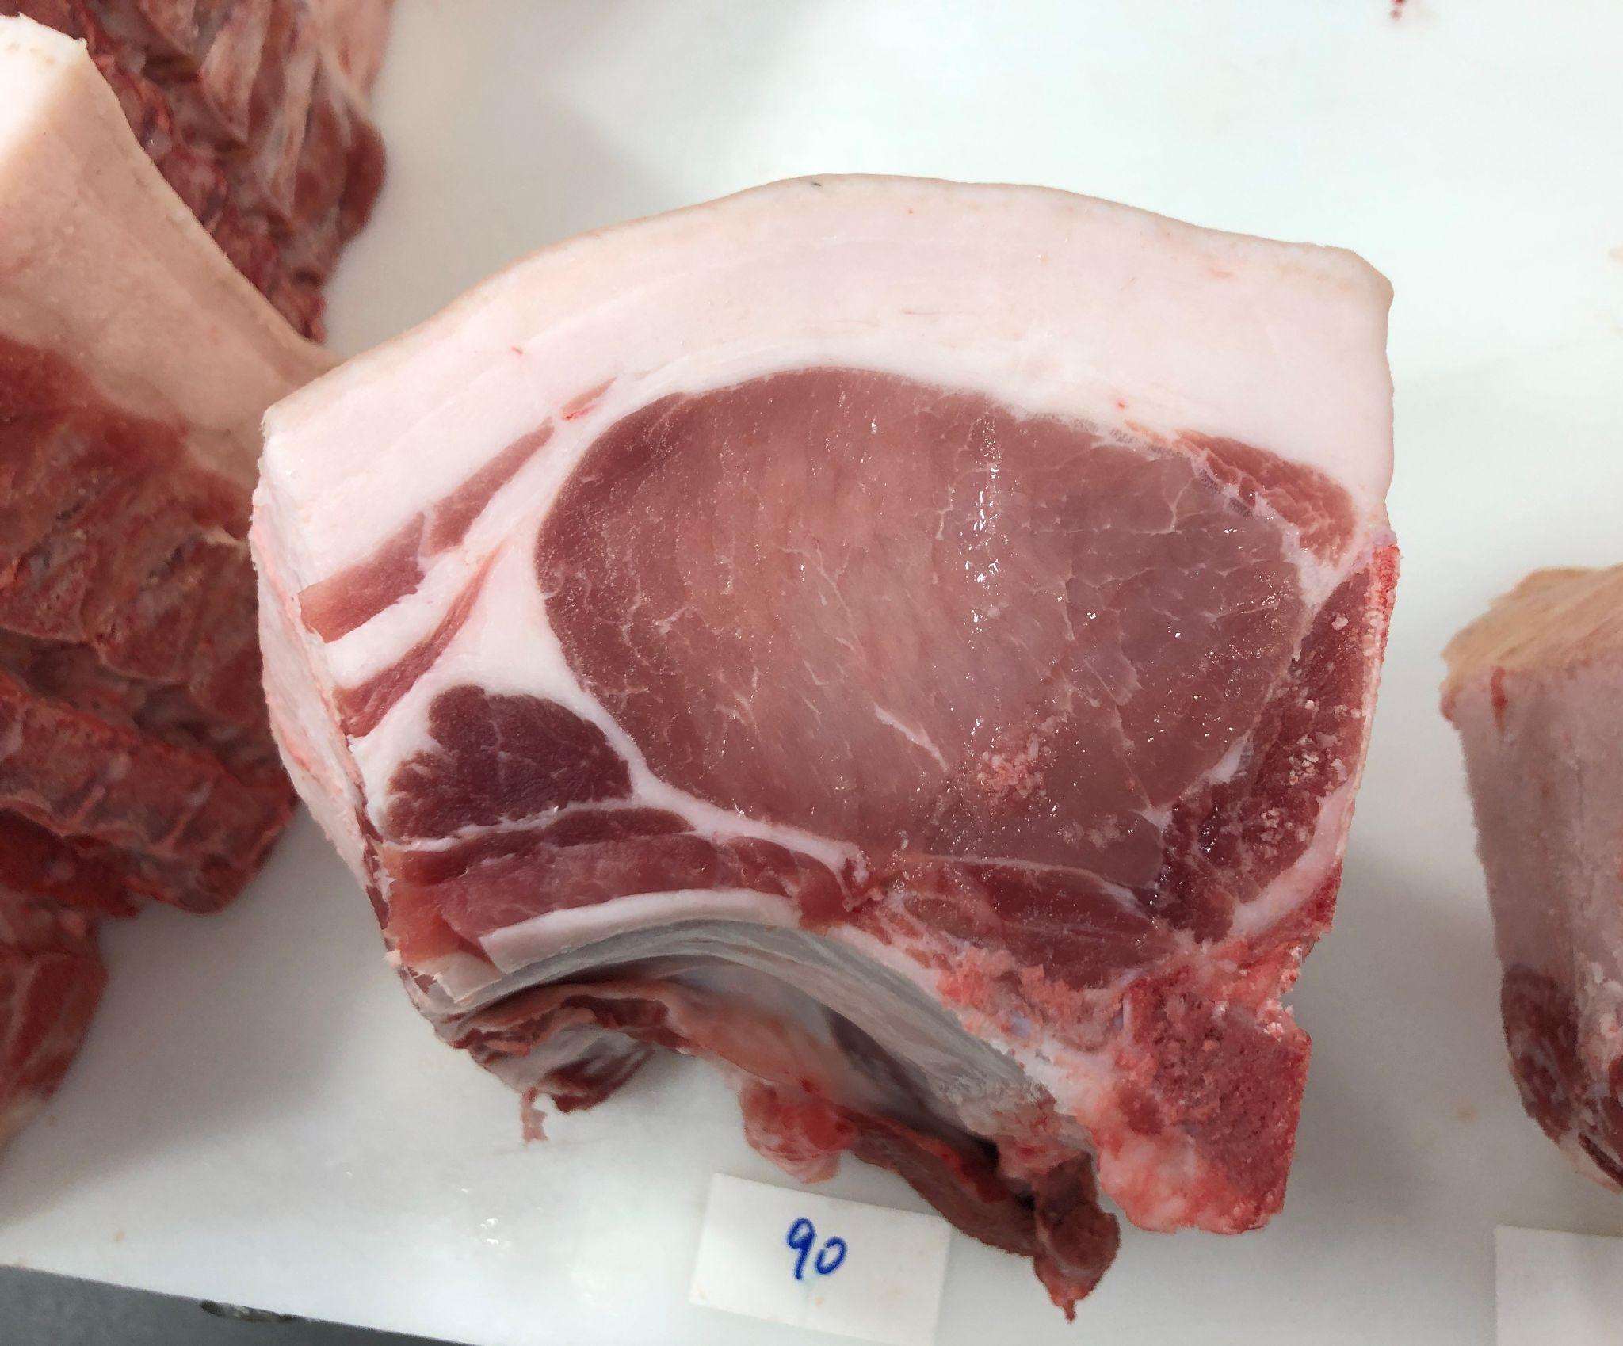
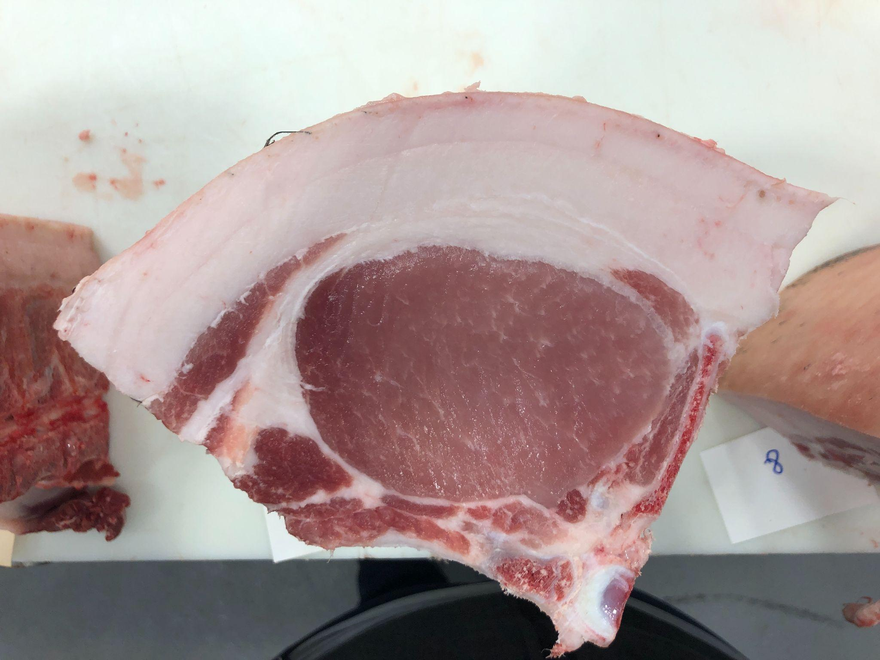
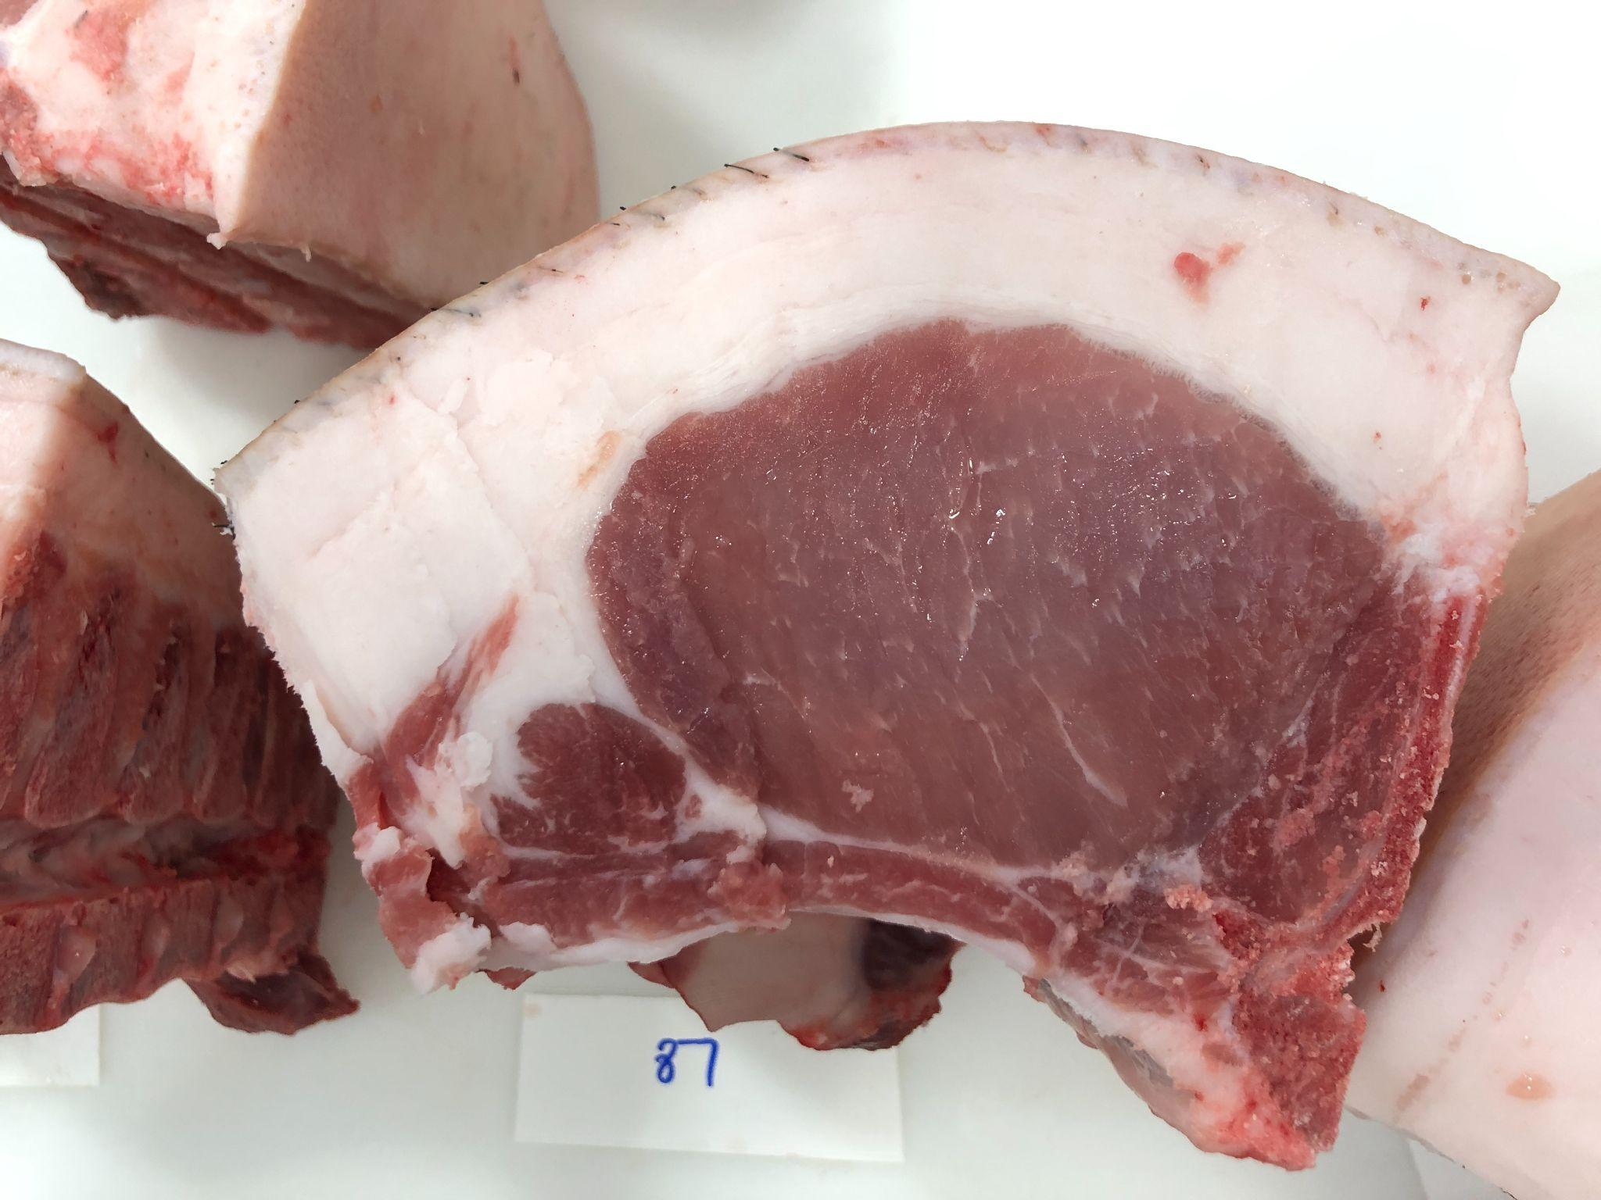
Pen 3: FKB9 B787 Dreamliner 12-6 BY BRAVO CATTLE-JOHN BARNES
119
126
127
129
134
139
1110
1111

Slide 5
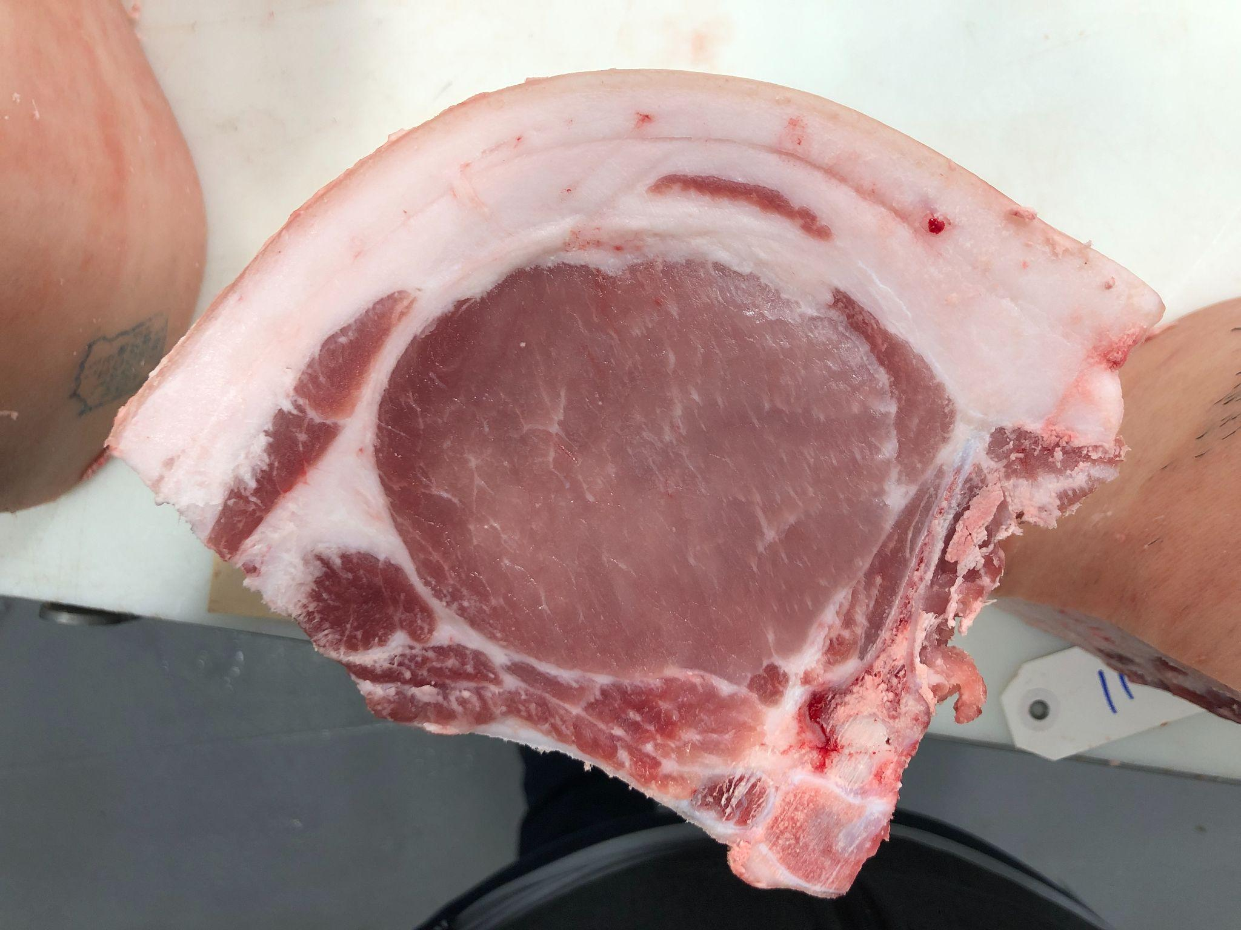
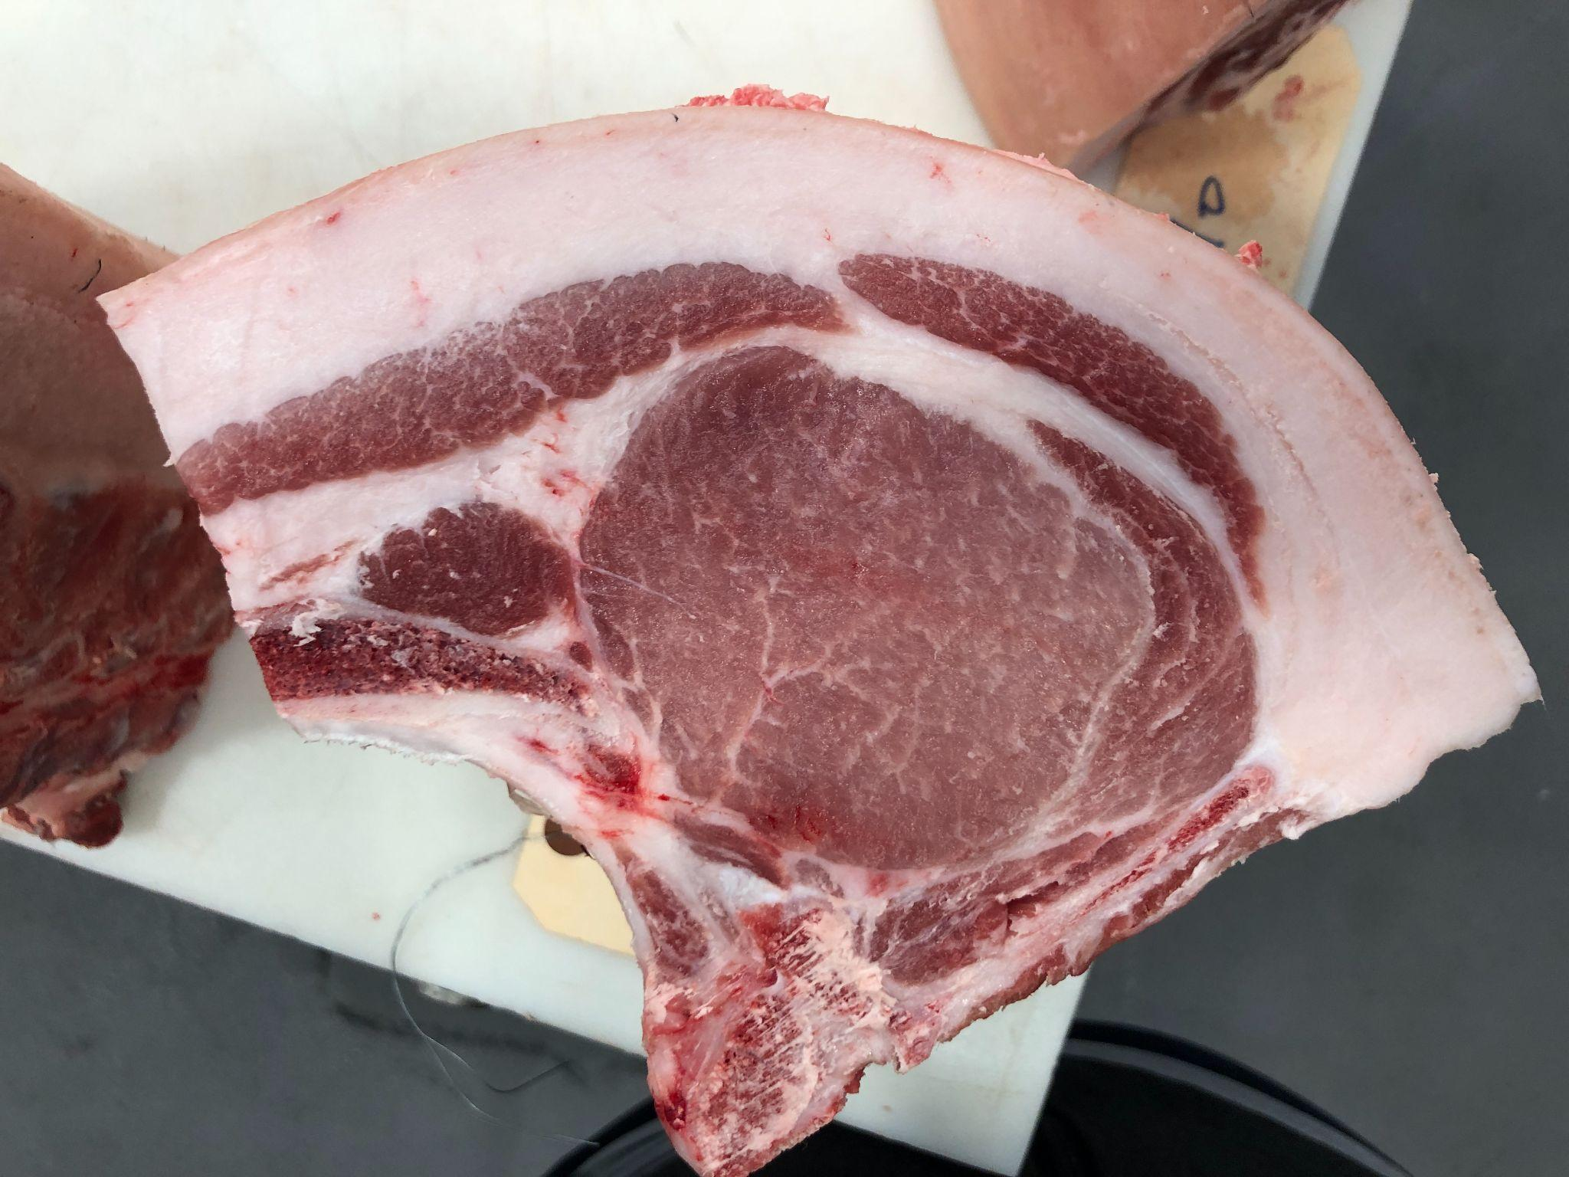
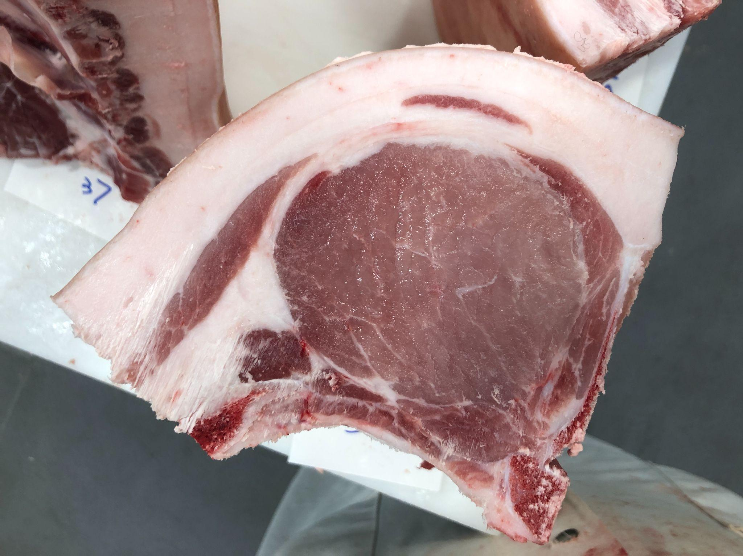
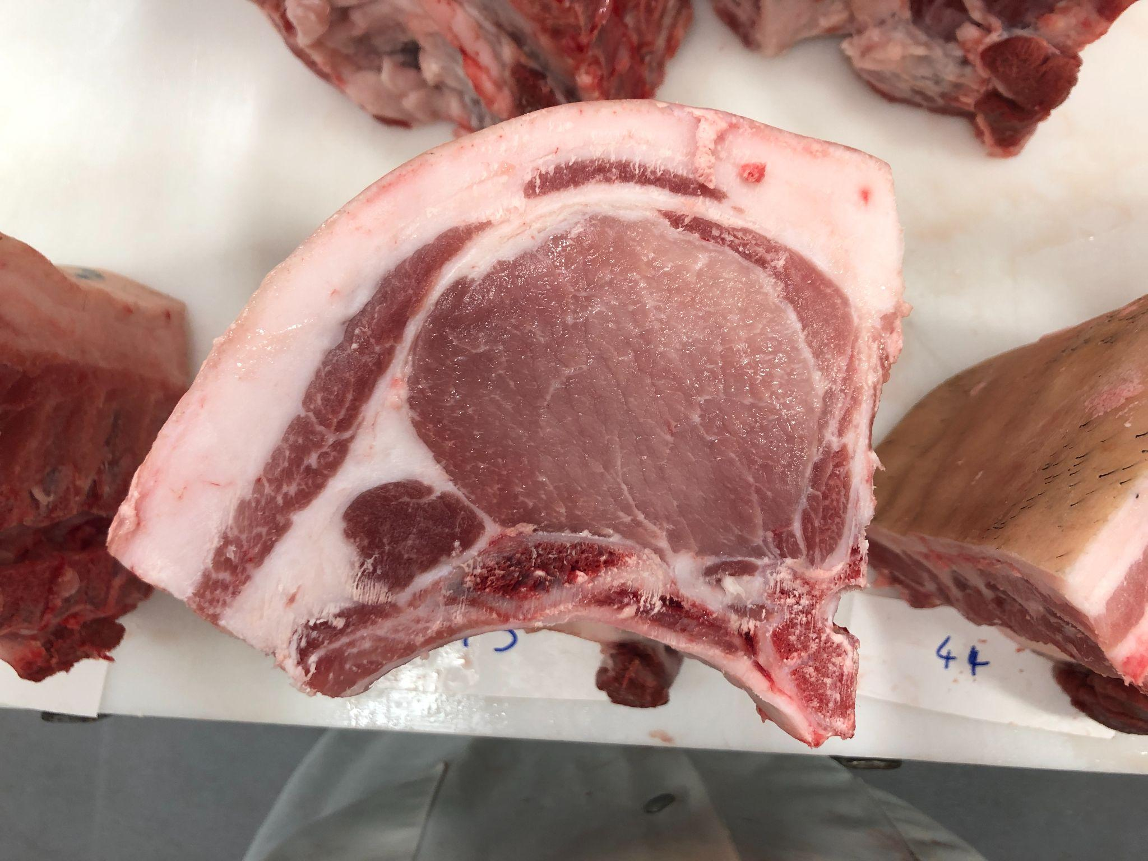
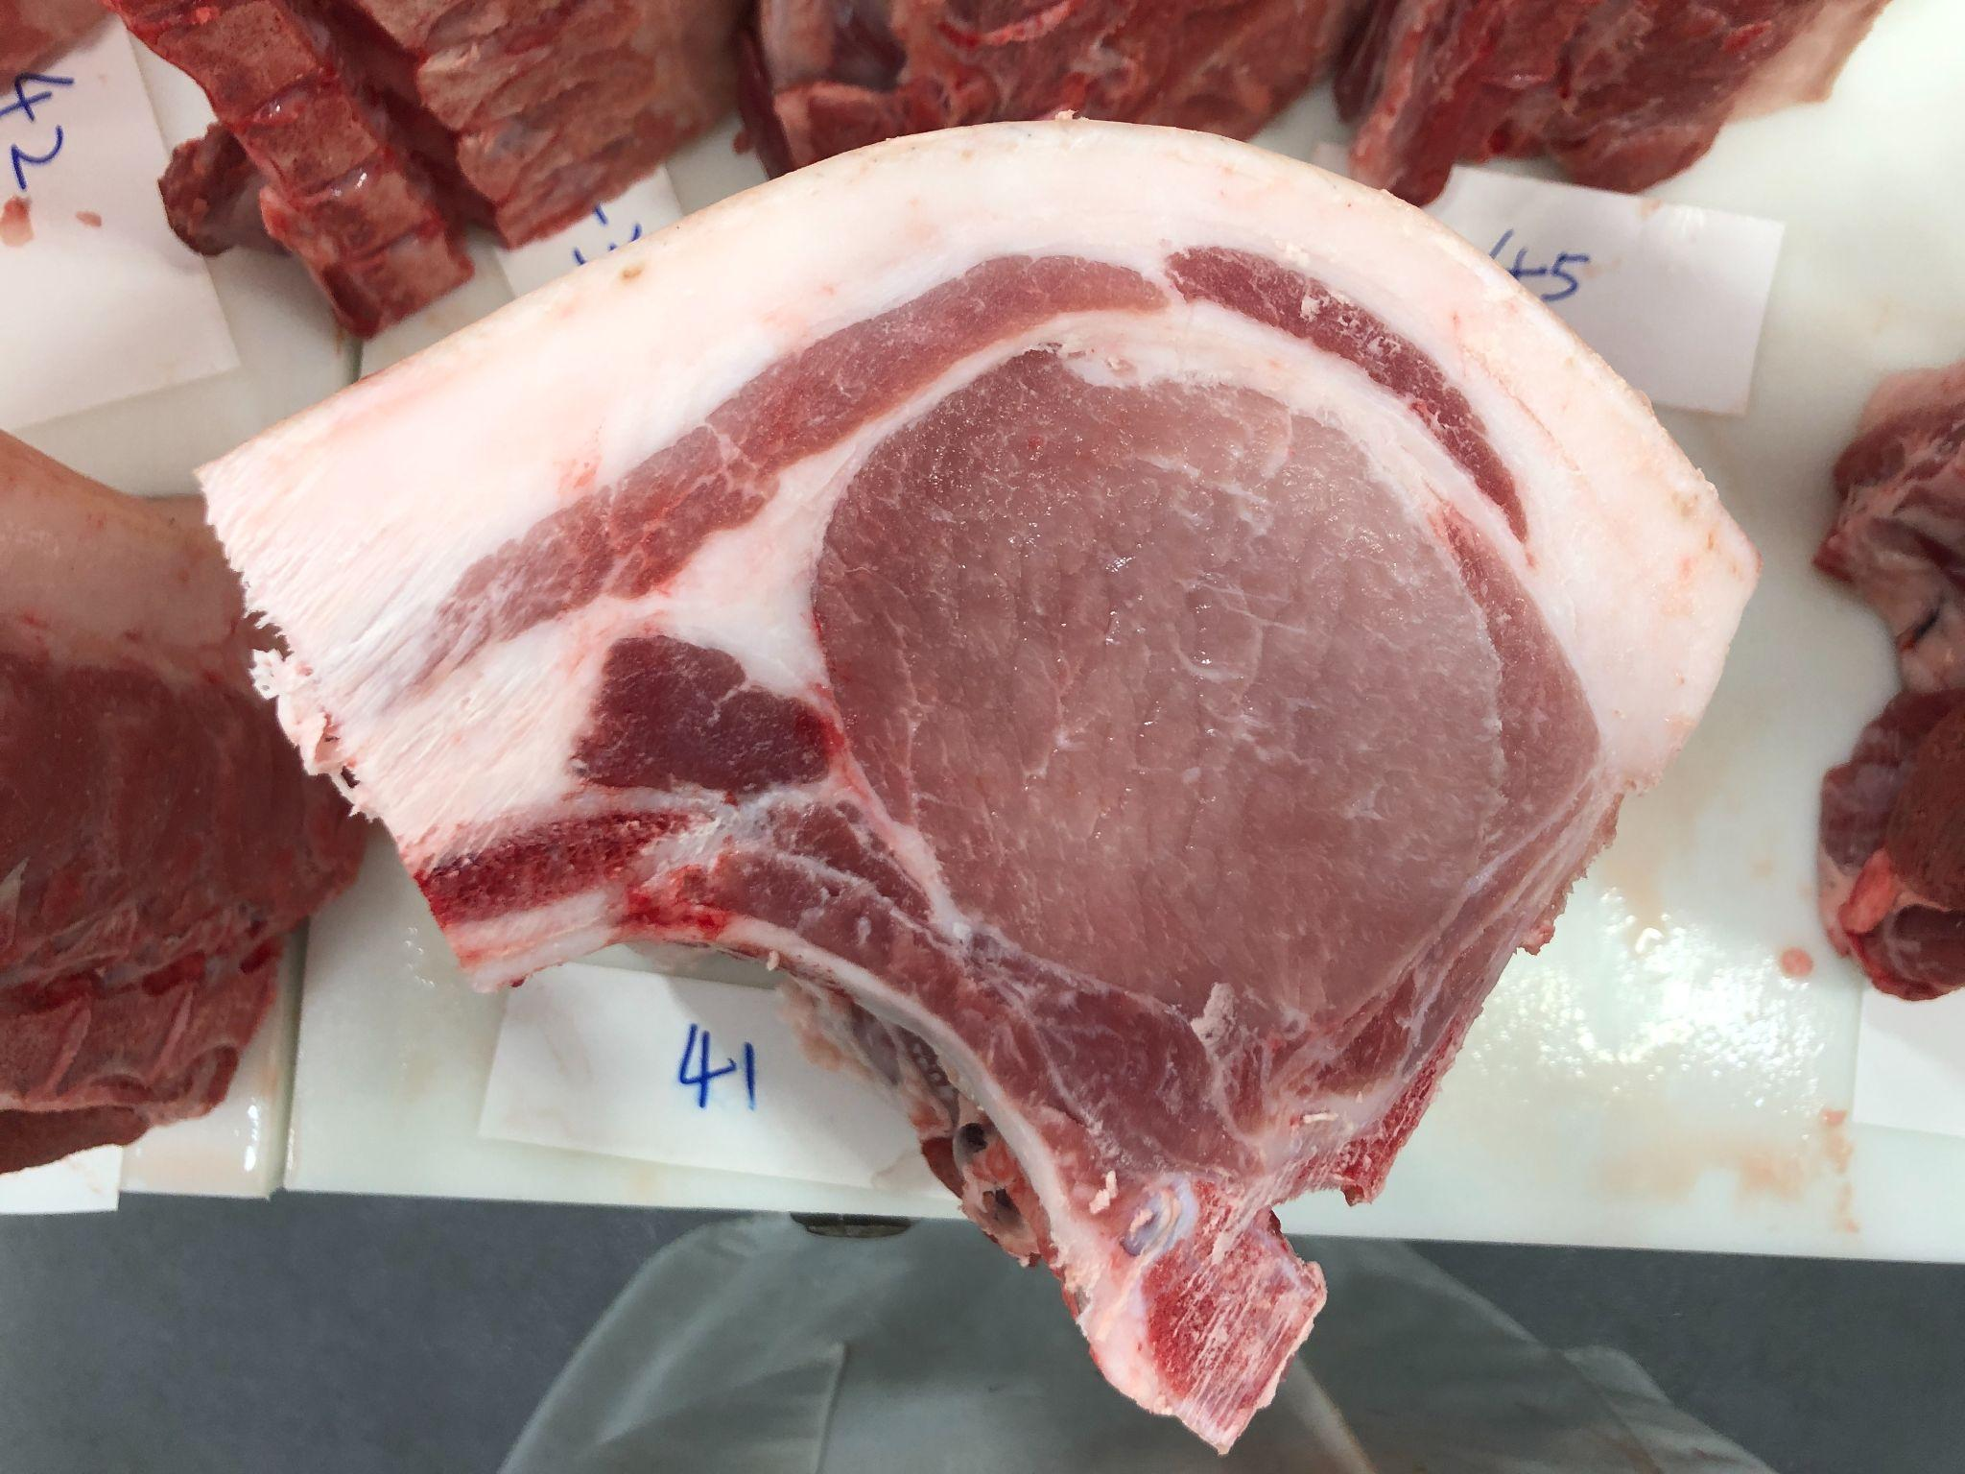
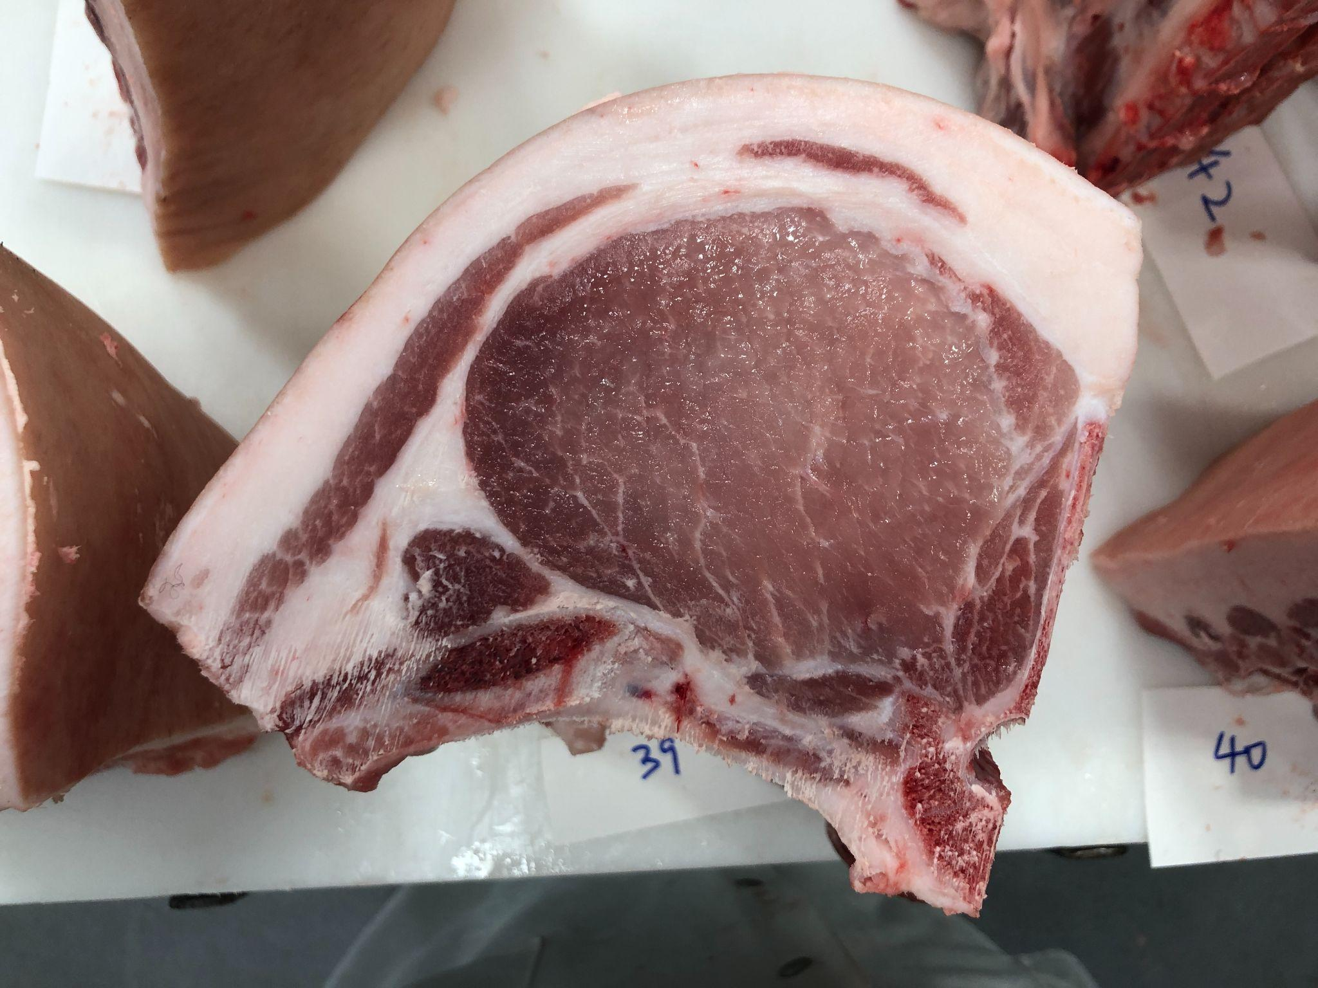
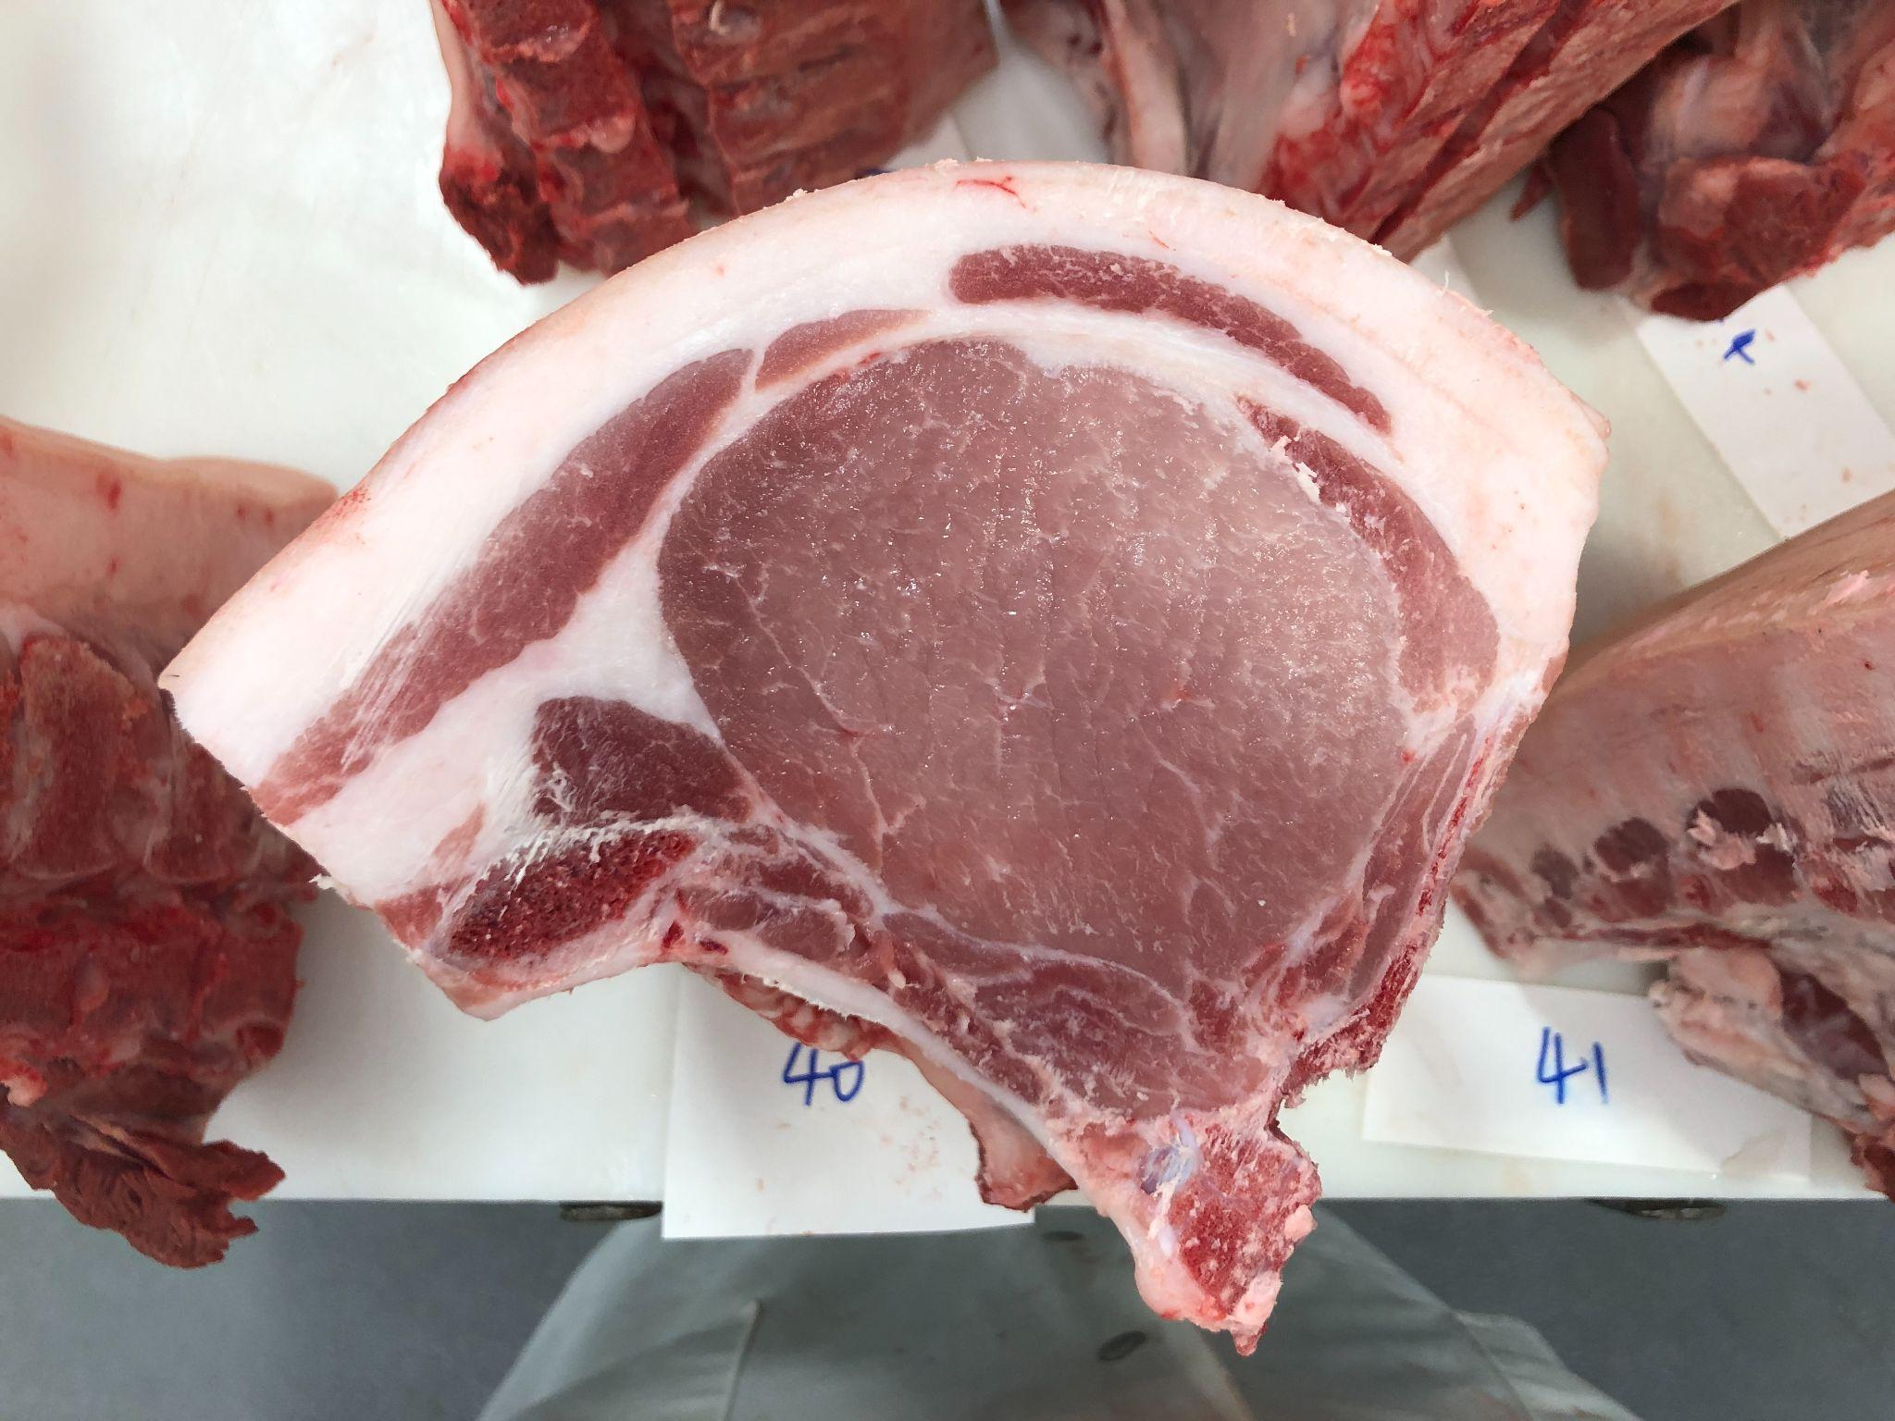
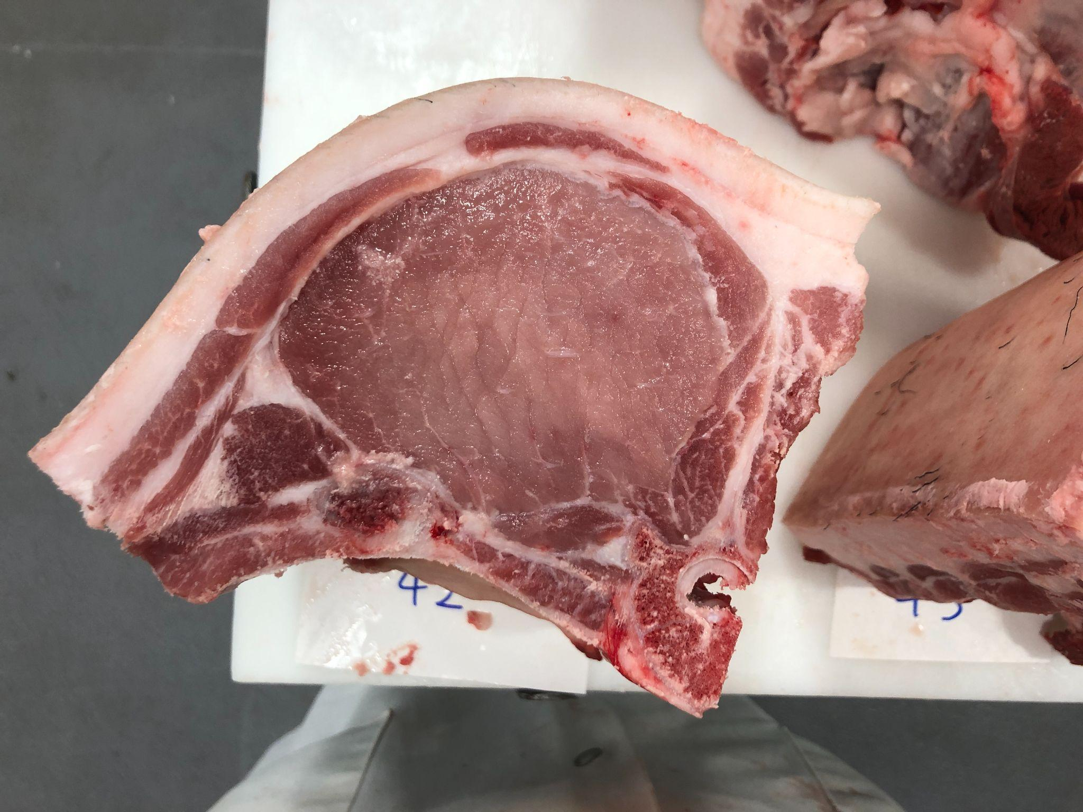
Pen 4: COP7 Dirty Monkey 14-8 BY FLY’N K BERKSHIRES
12
14
17
18
26
28
30
32

Slide 6
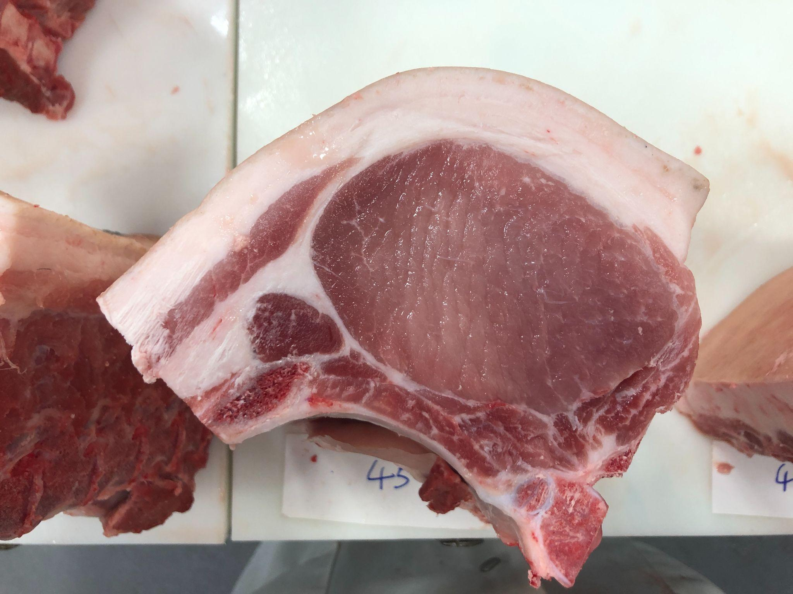
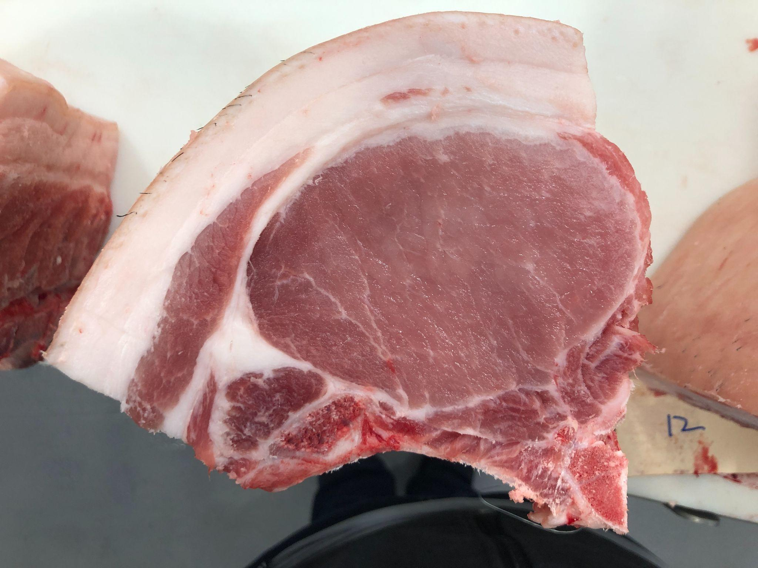
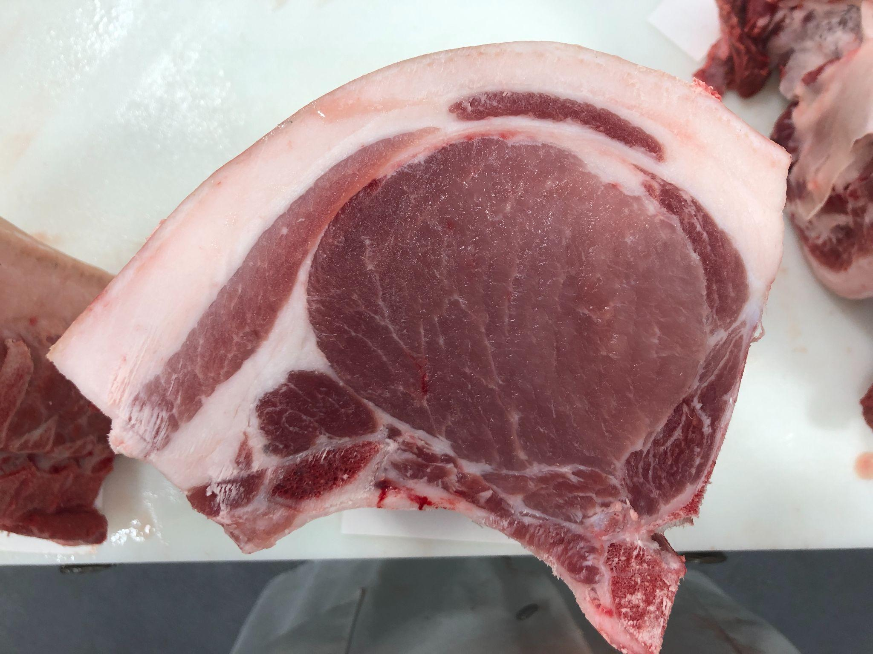
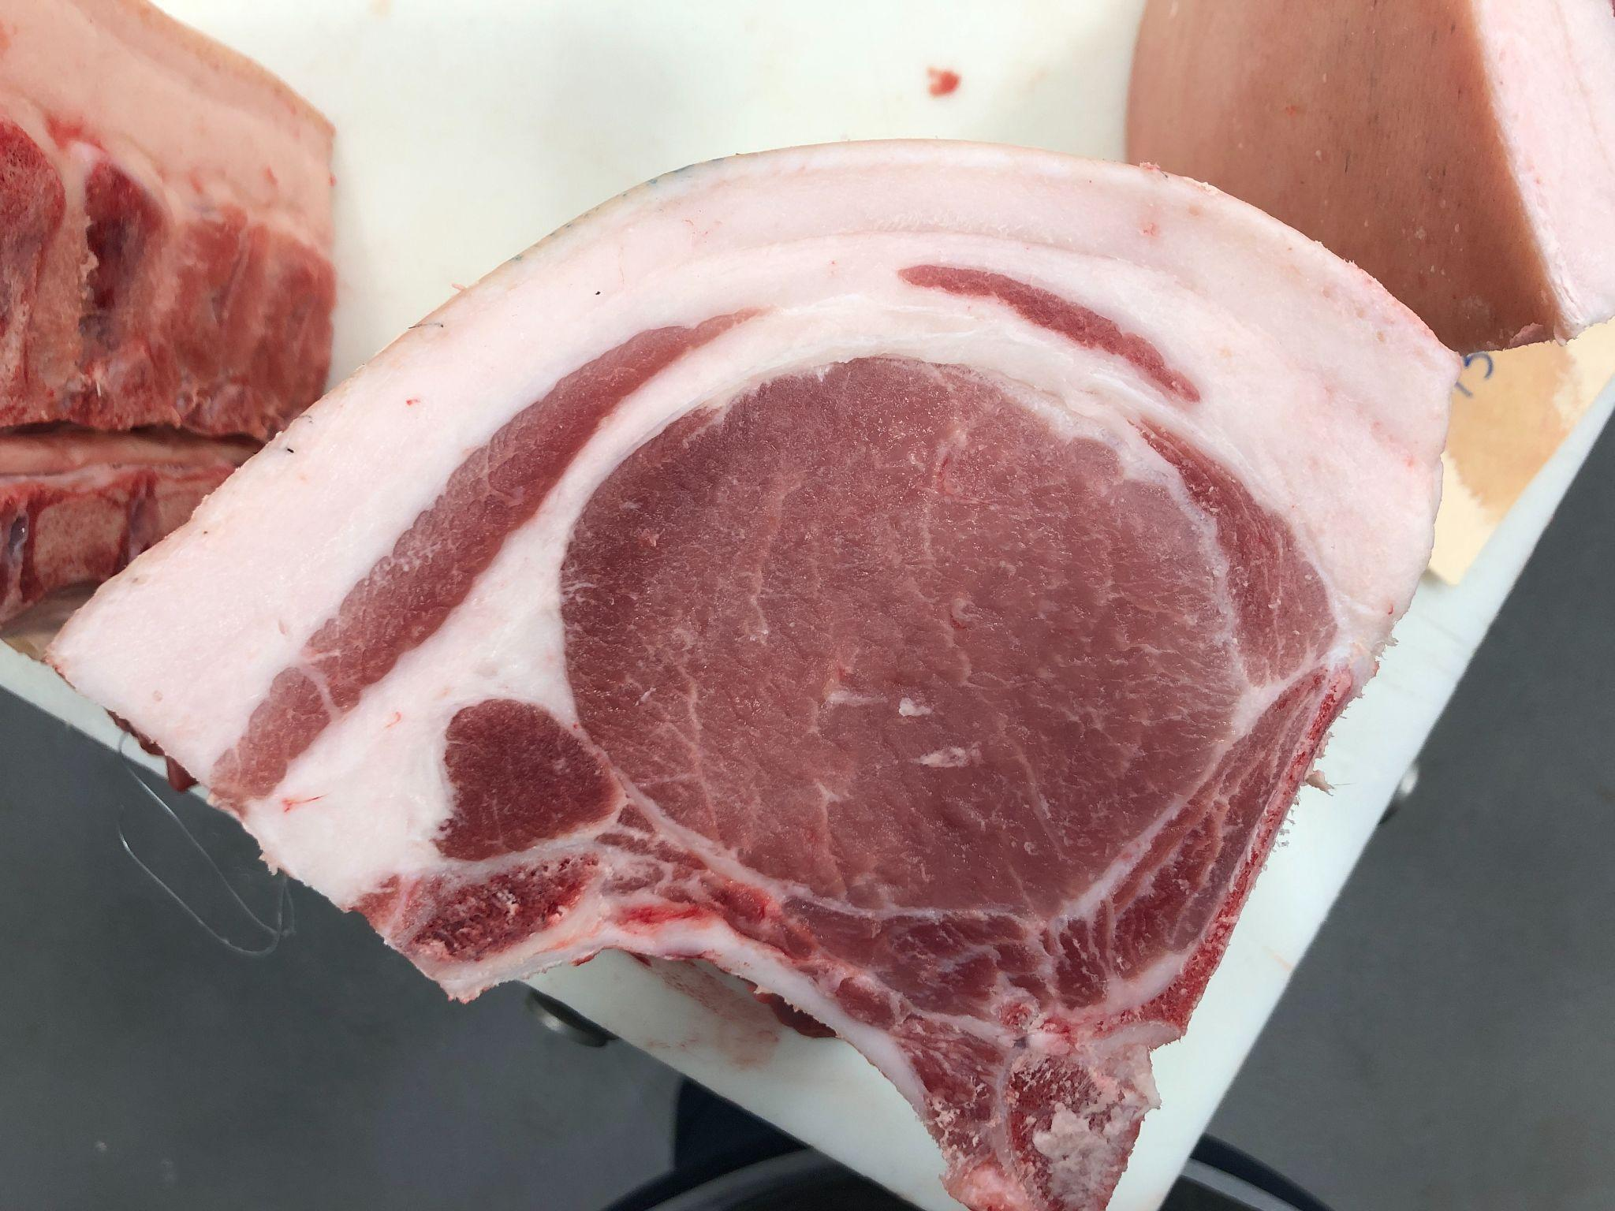
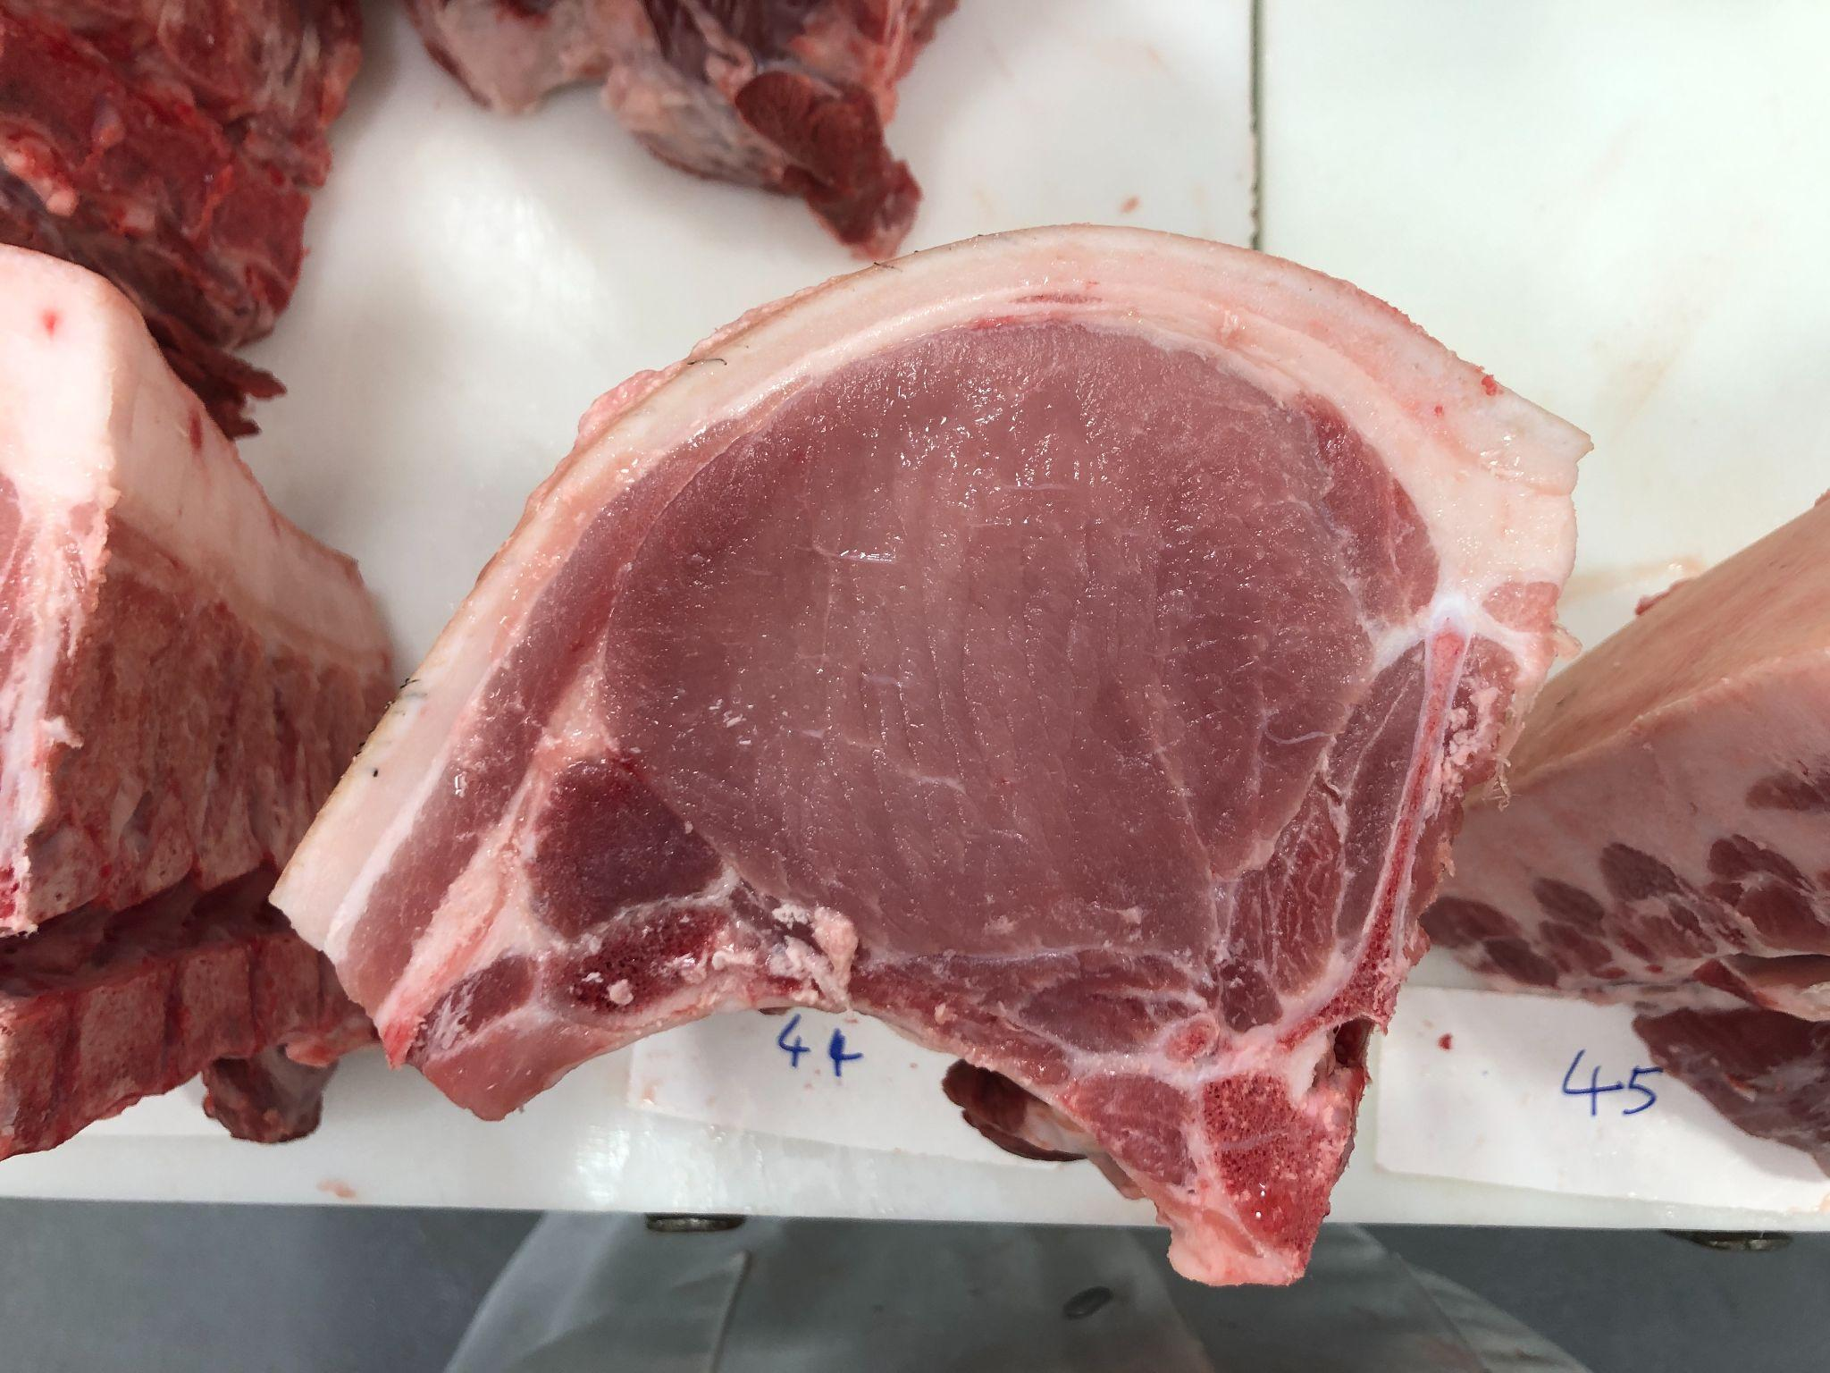
Pen 5: FKB7 B787 Dreamliner 53-5 BY CHAD KREMPER
3
6
7
8
10

Slide 7
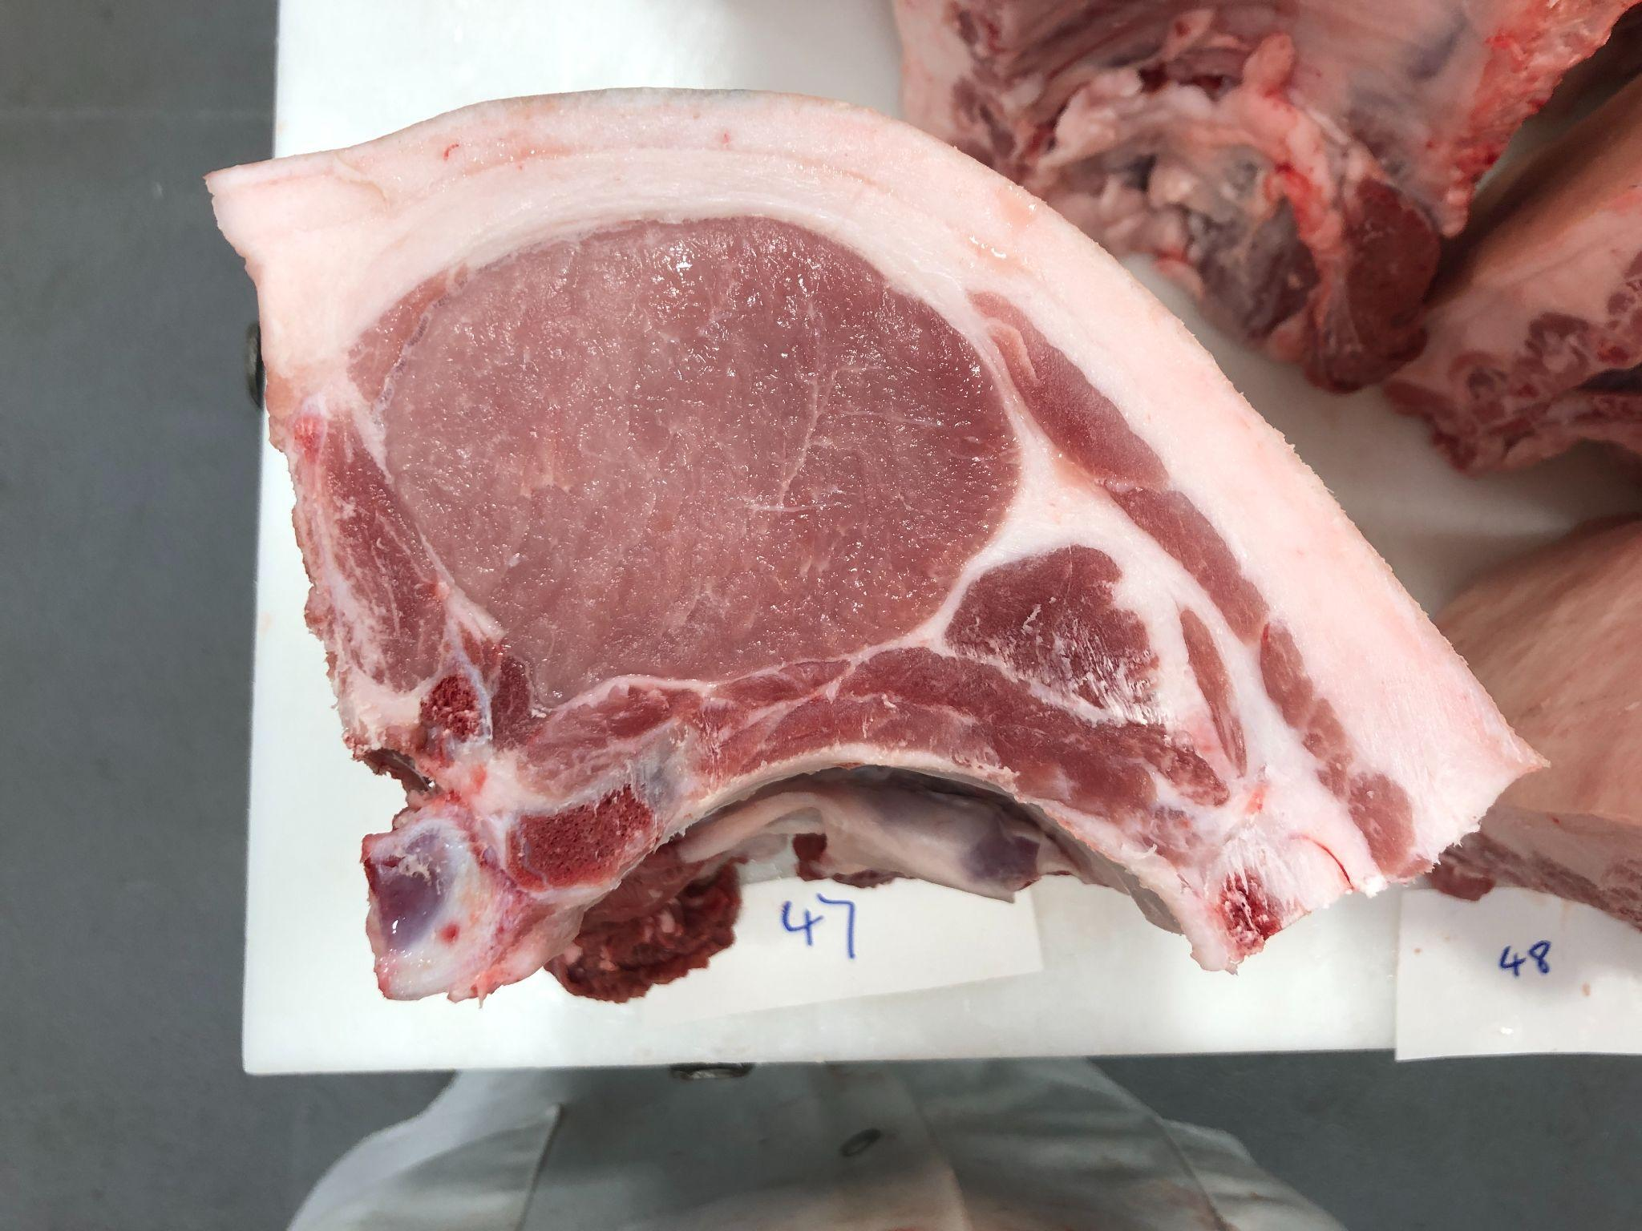
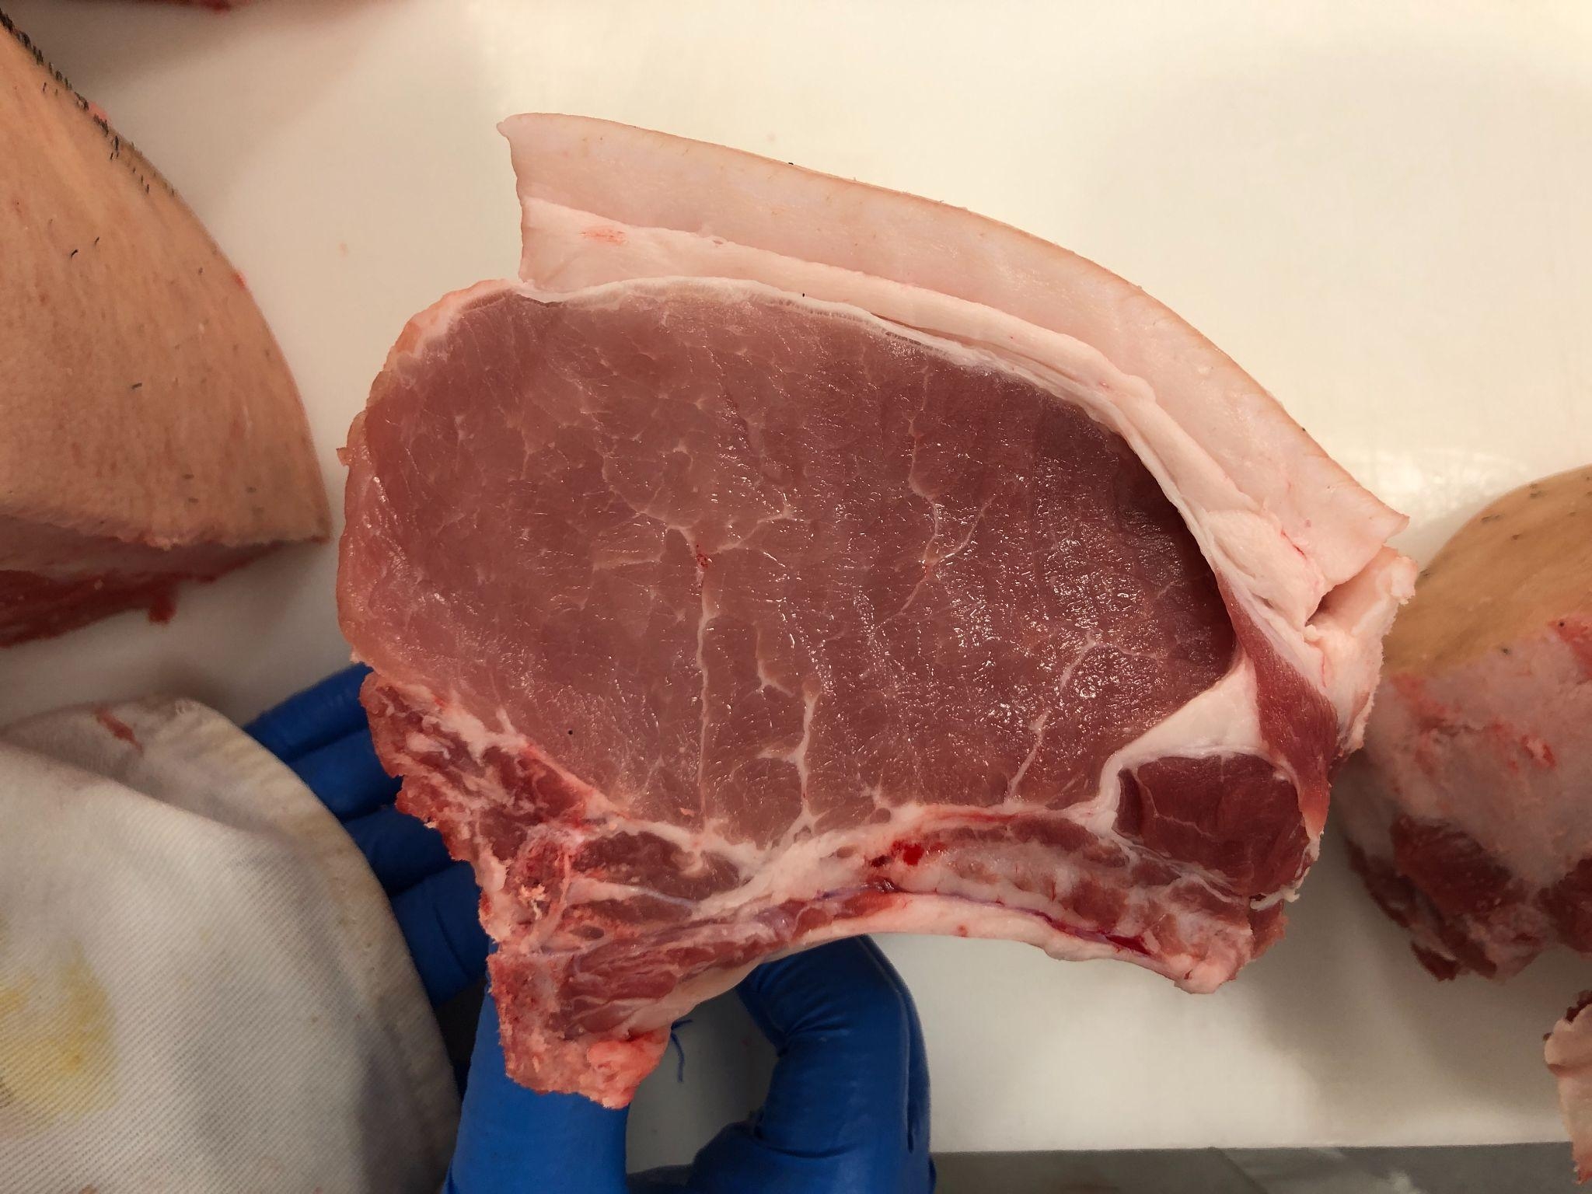
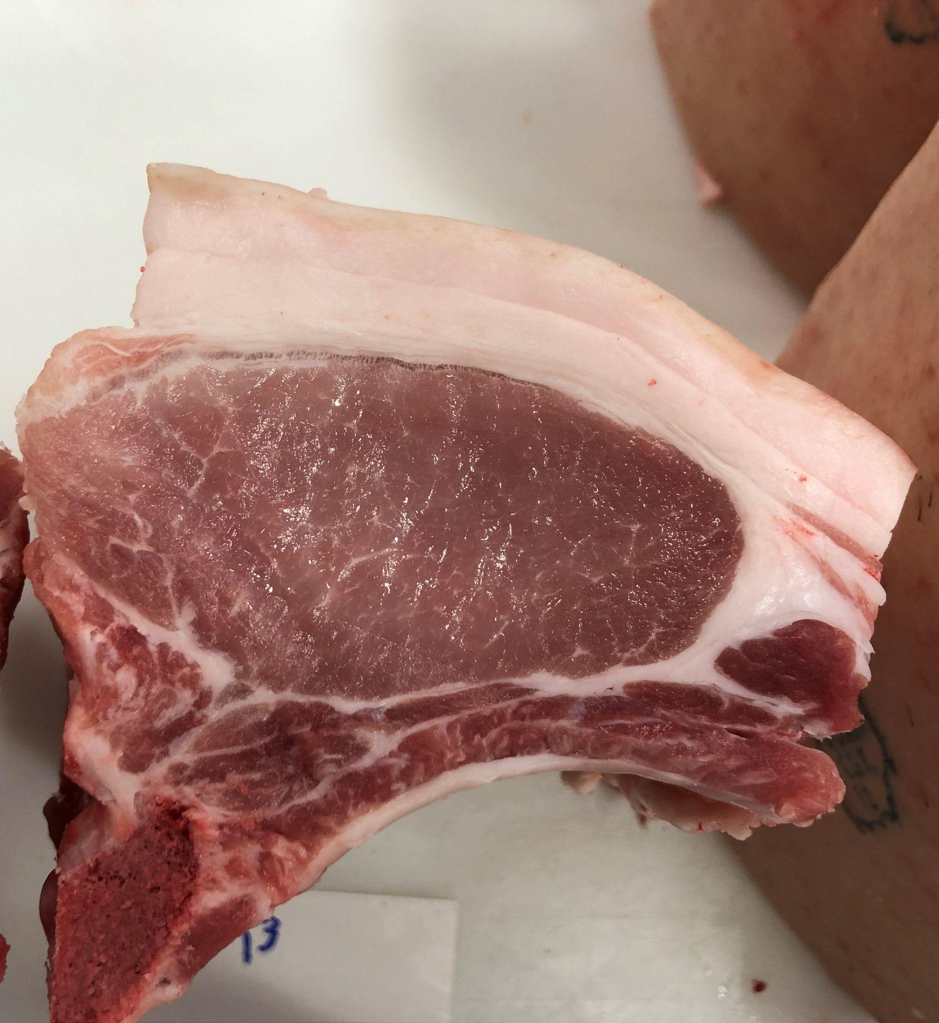
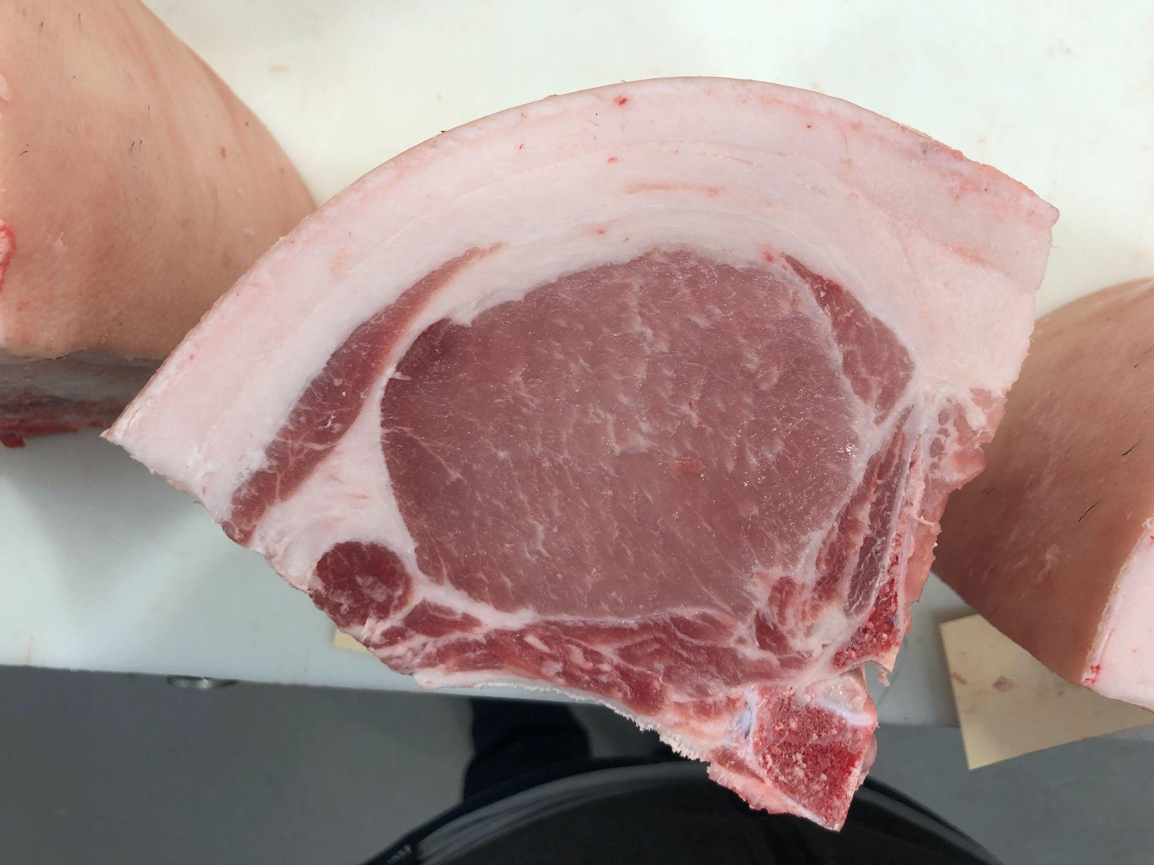
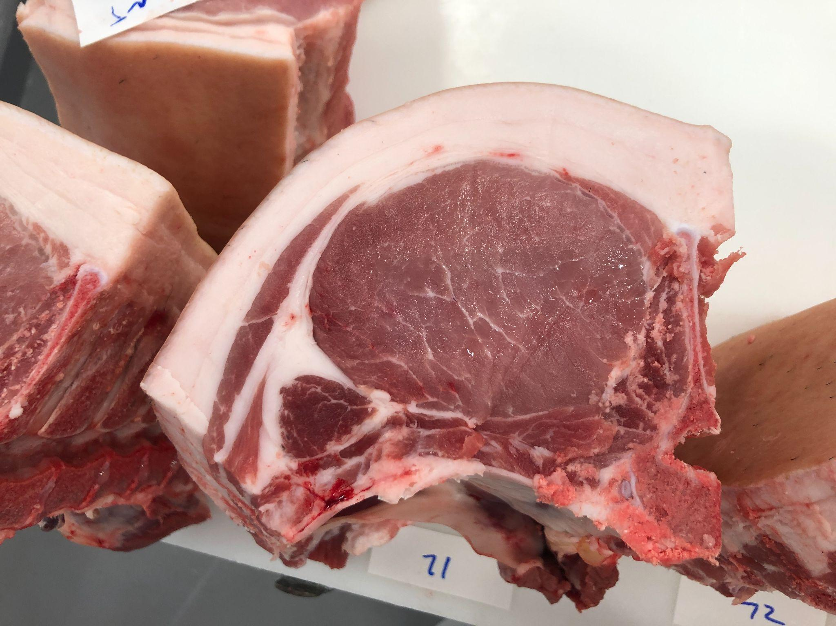
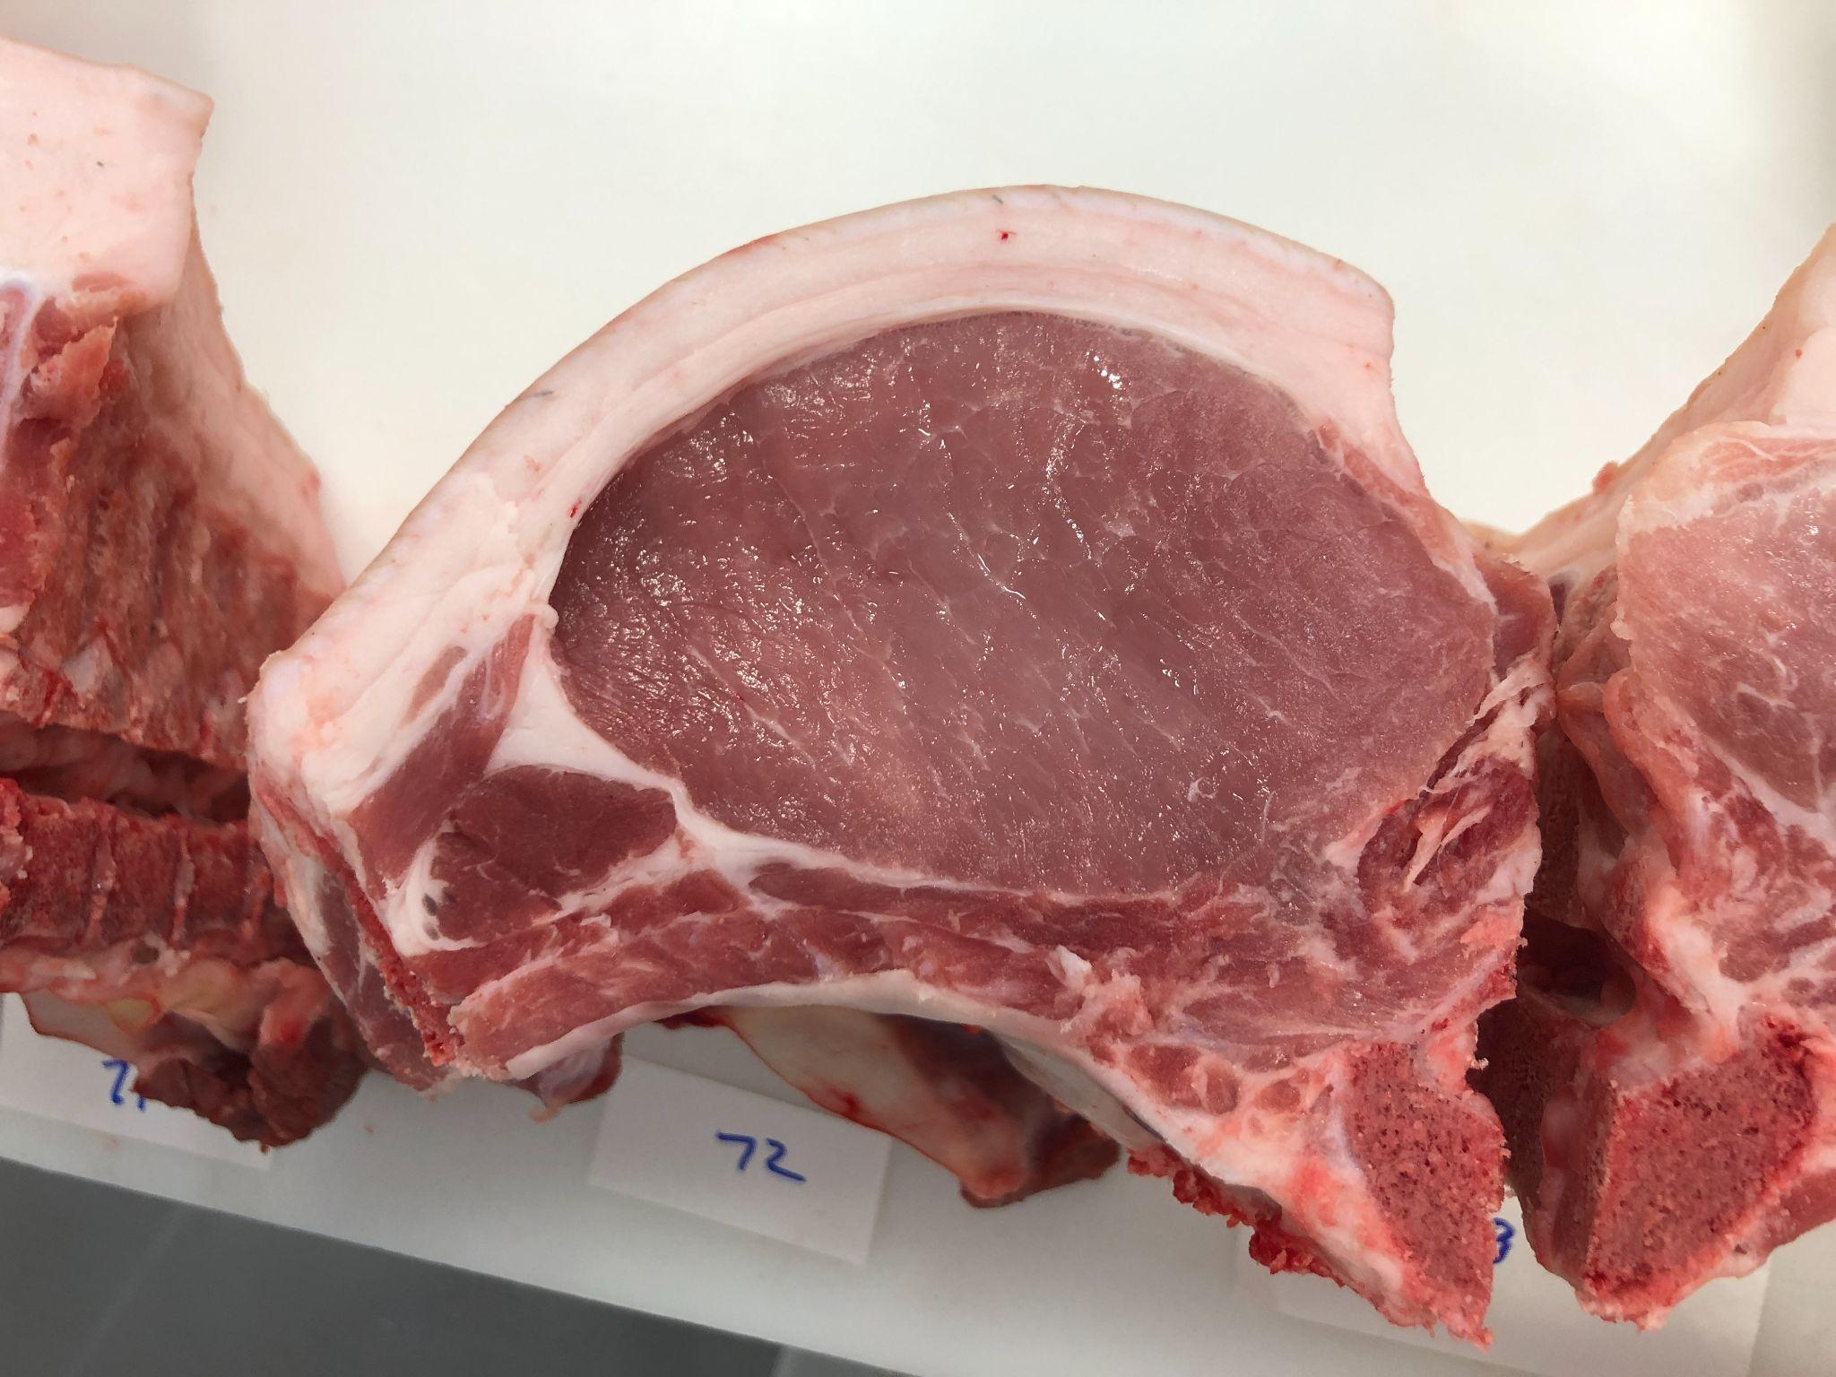
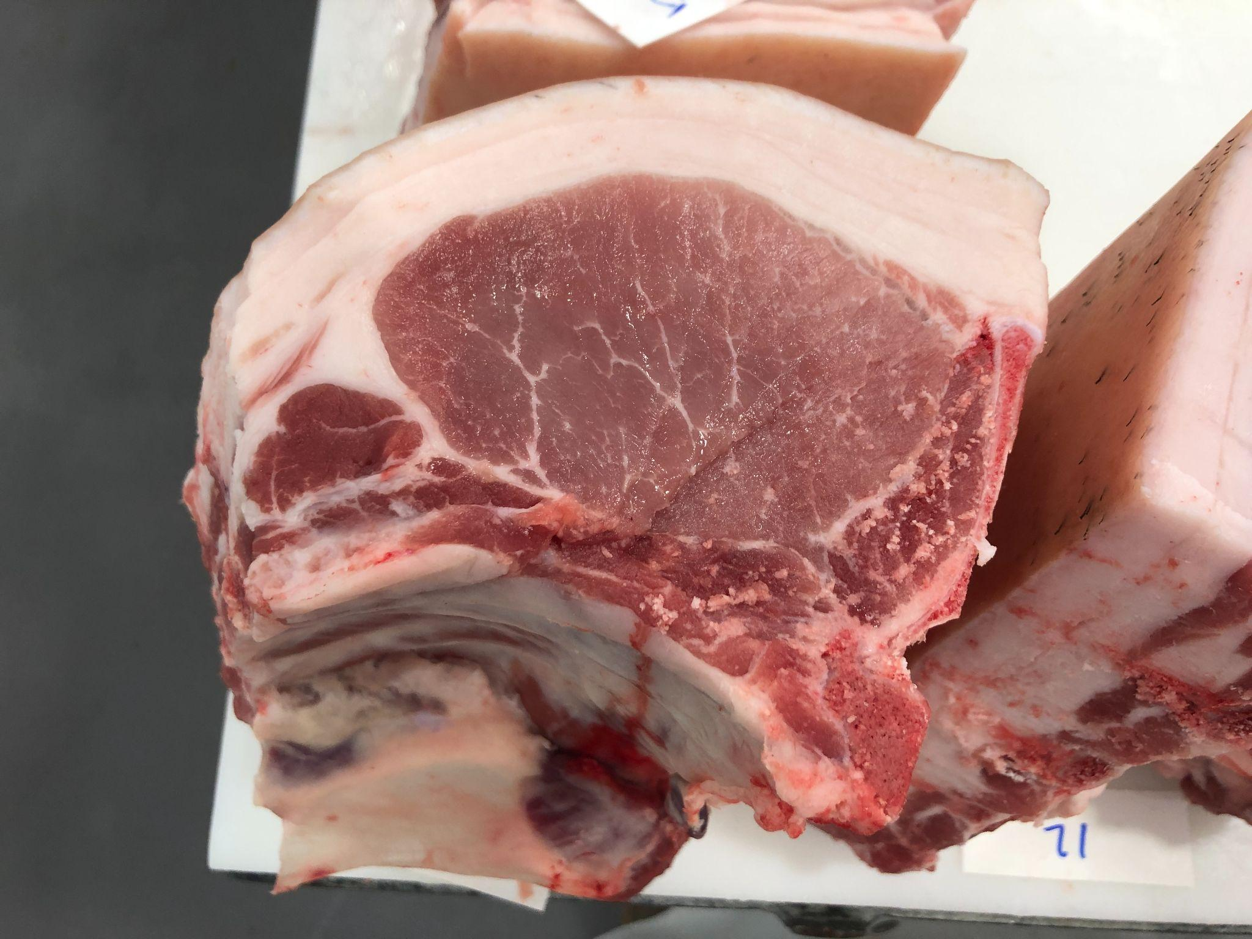
Pen 6: AJC8 Warhorse 7-3 BY AJC BERKSHIRES
11
13
14
15
16
17
18

Slide 8
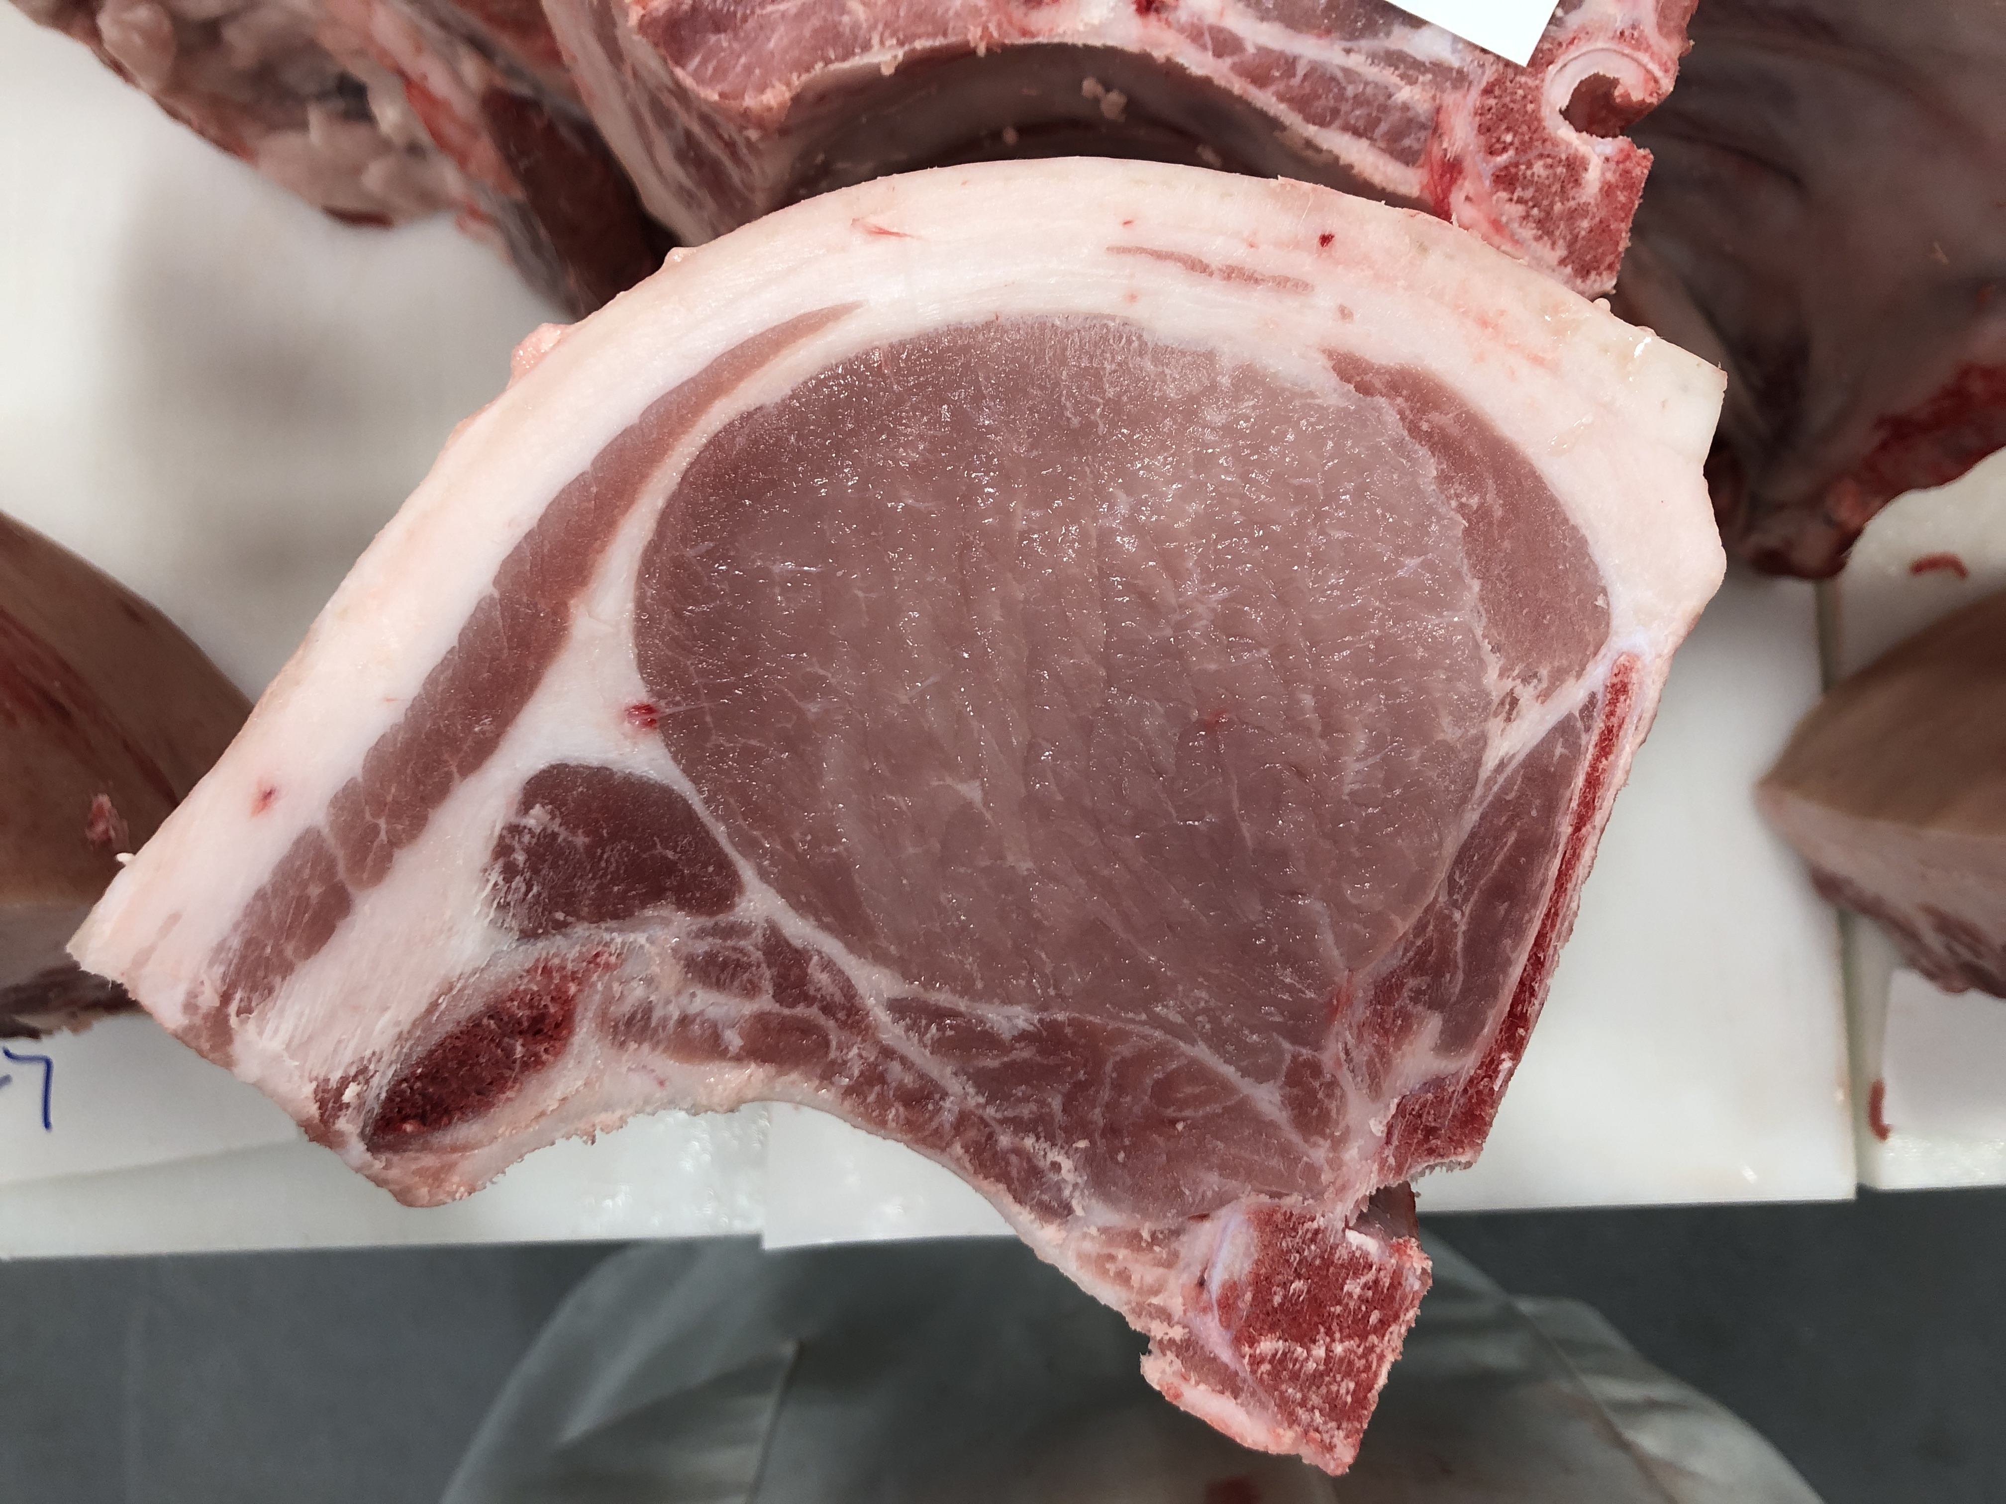
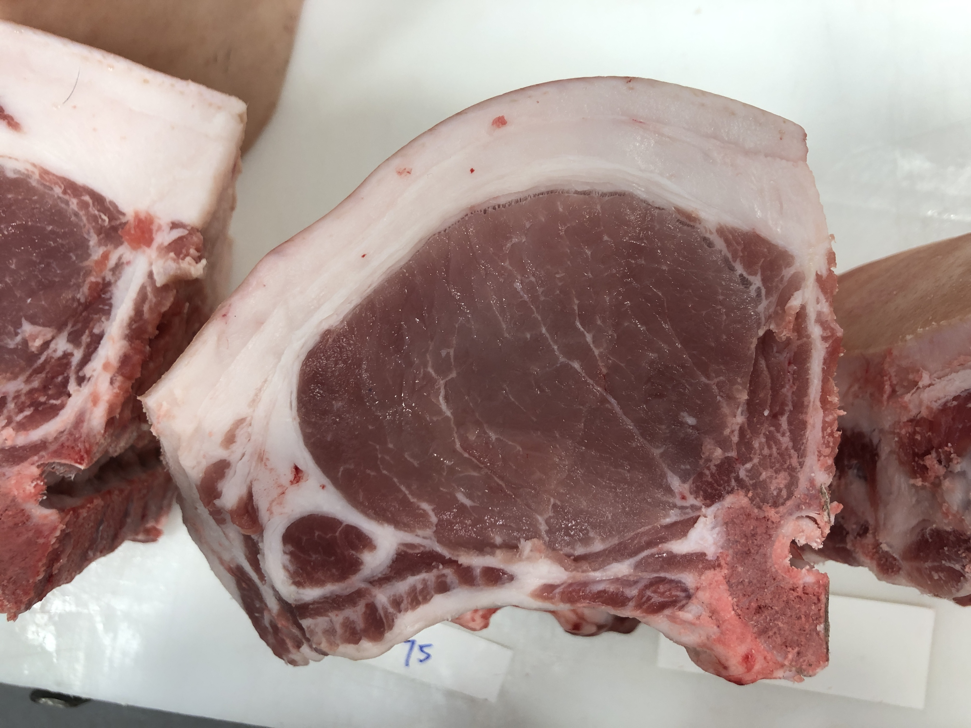
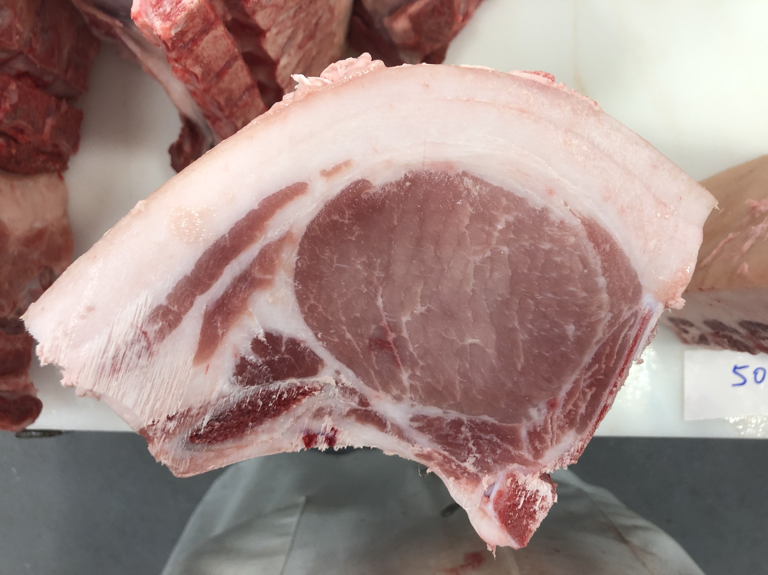
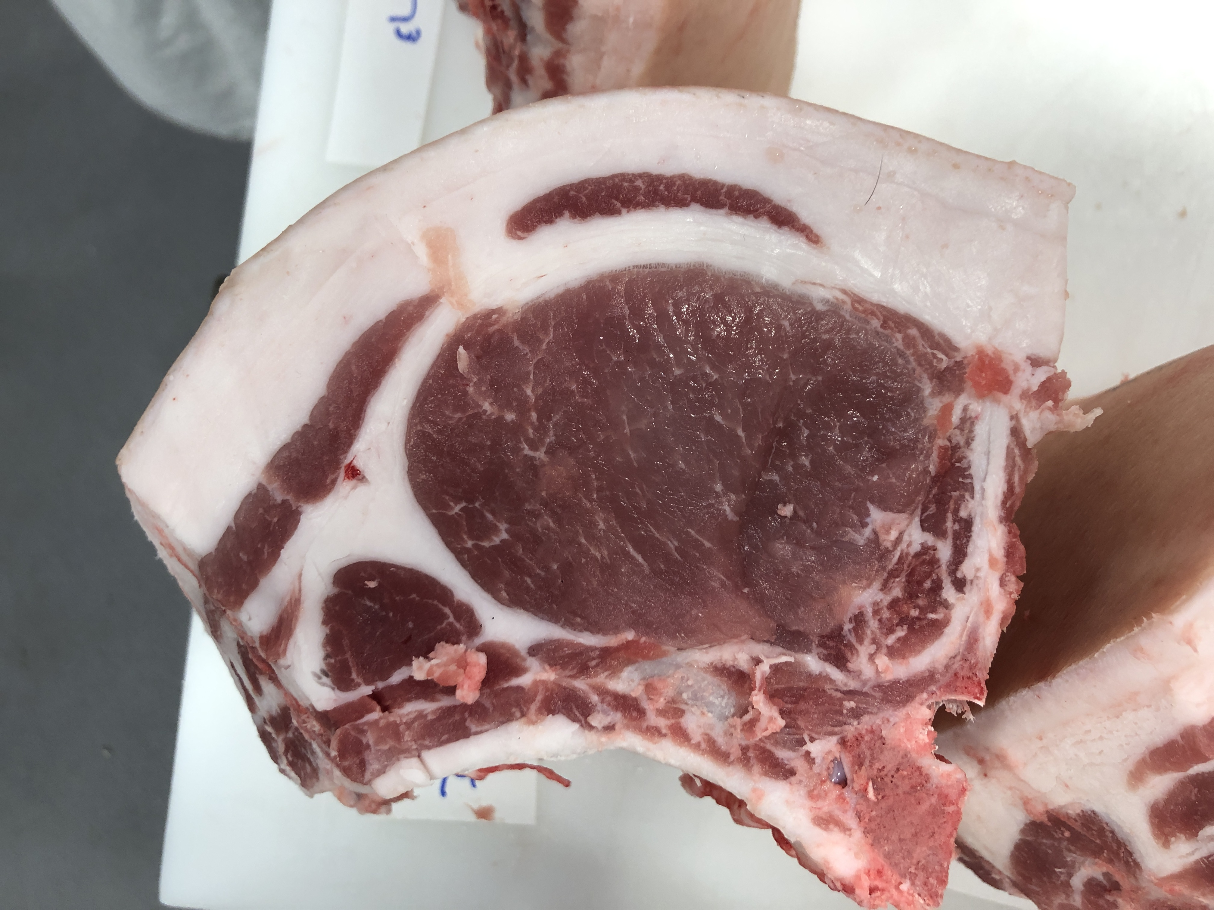
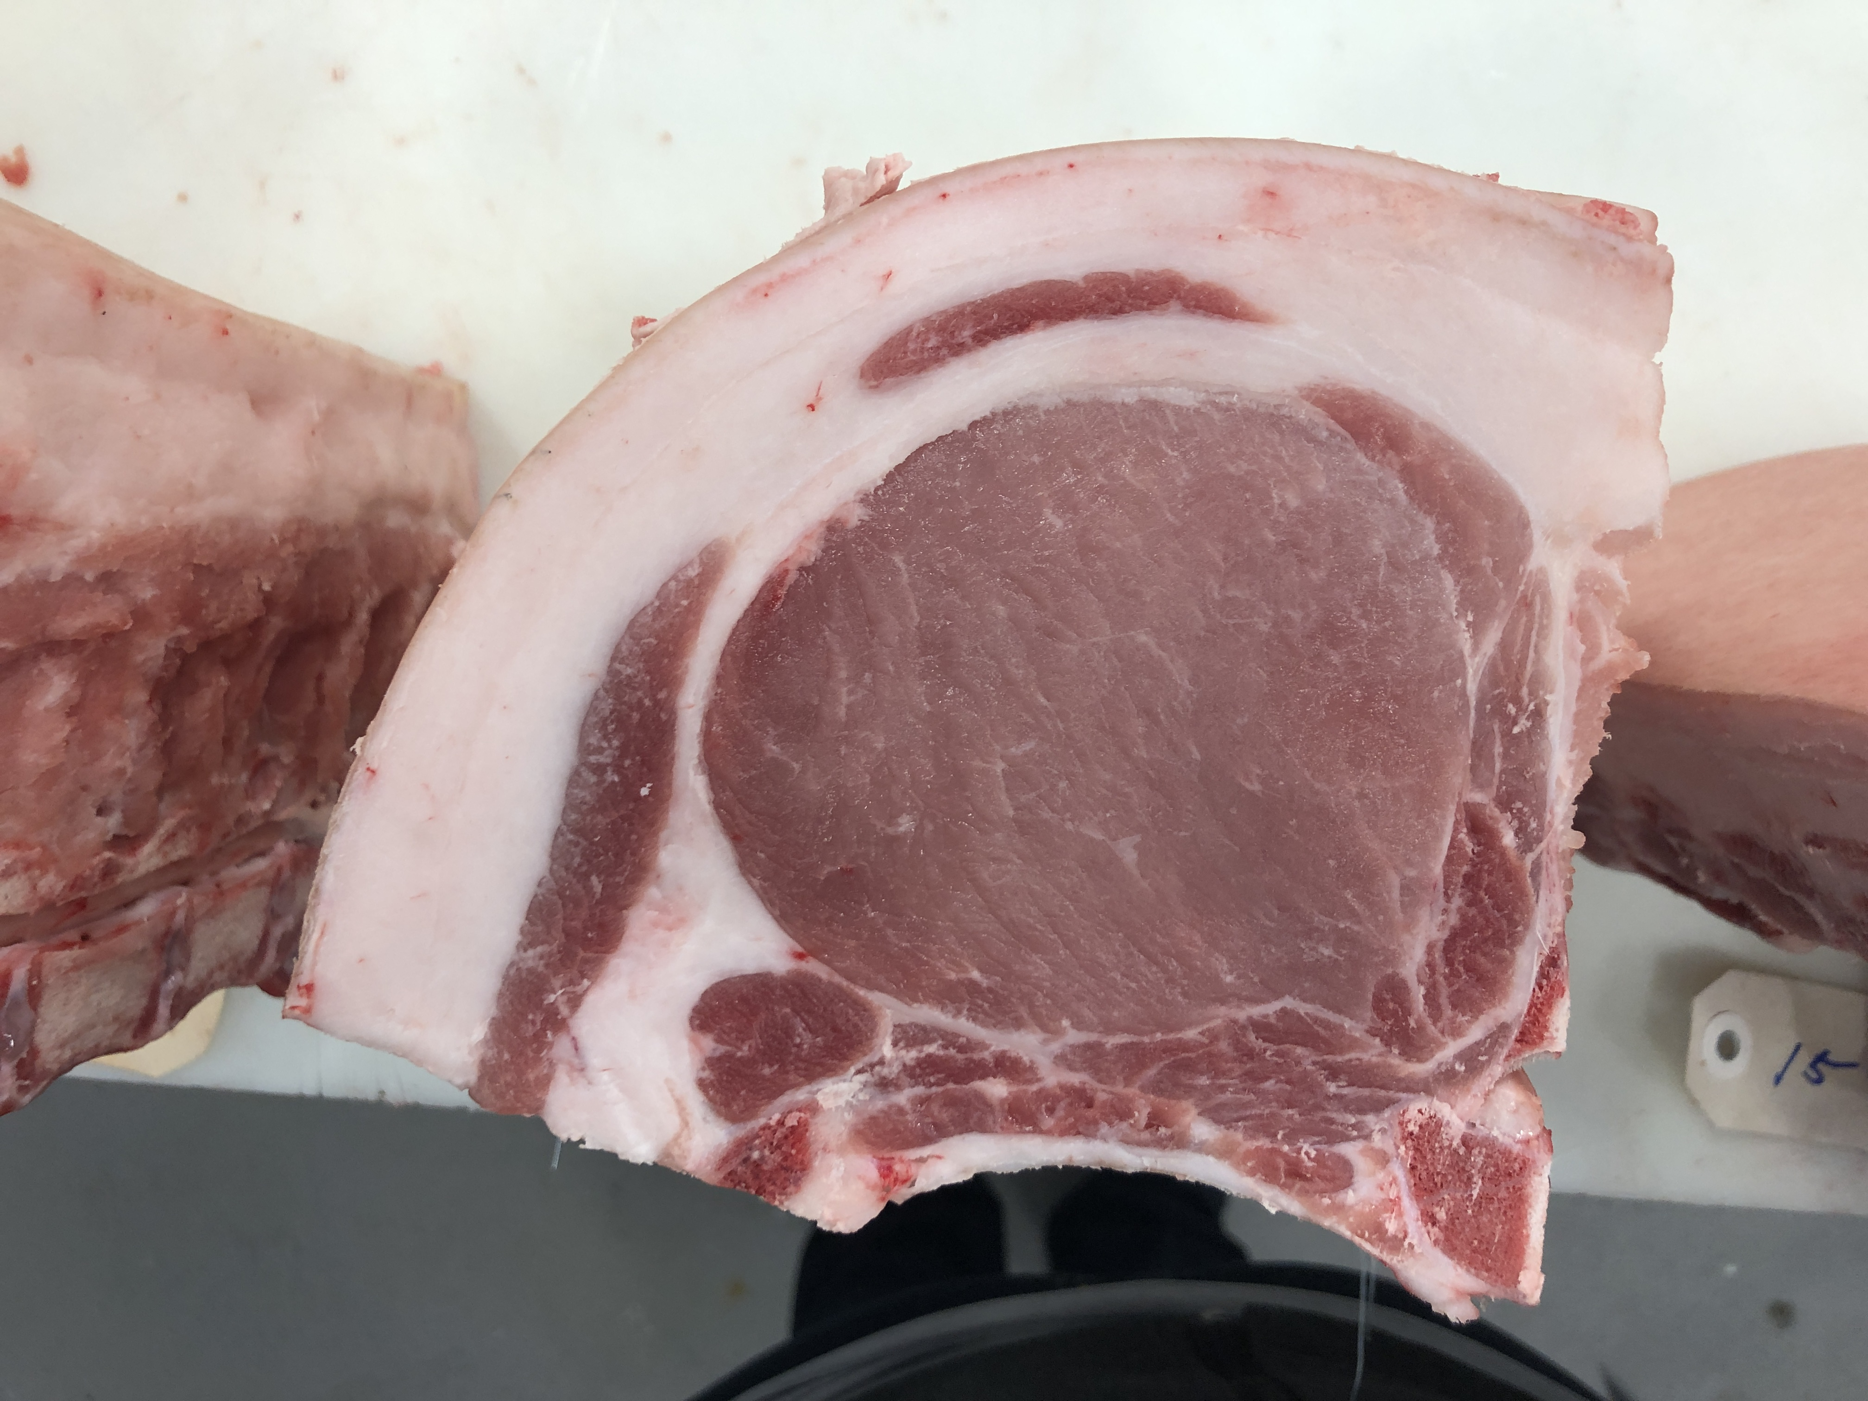
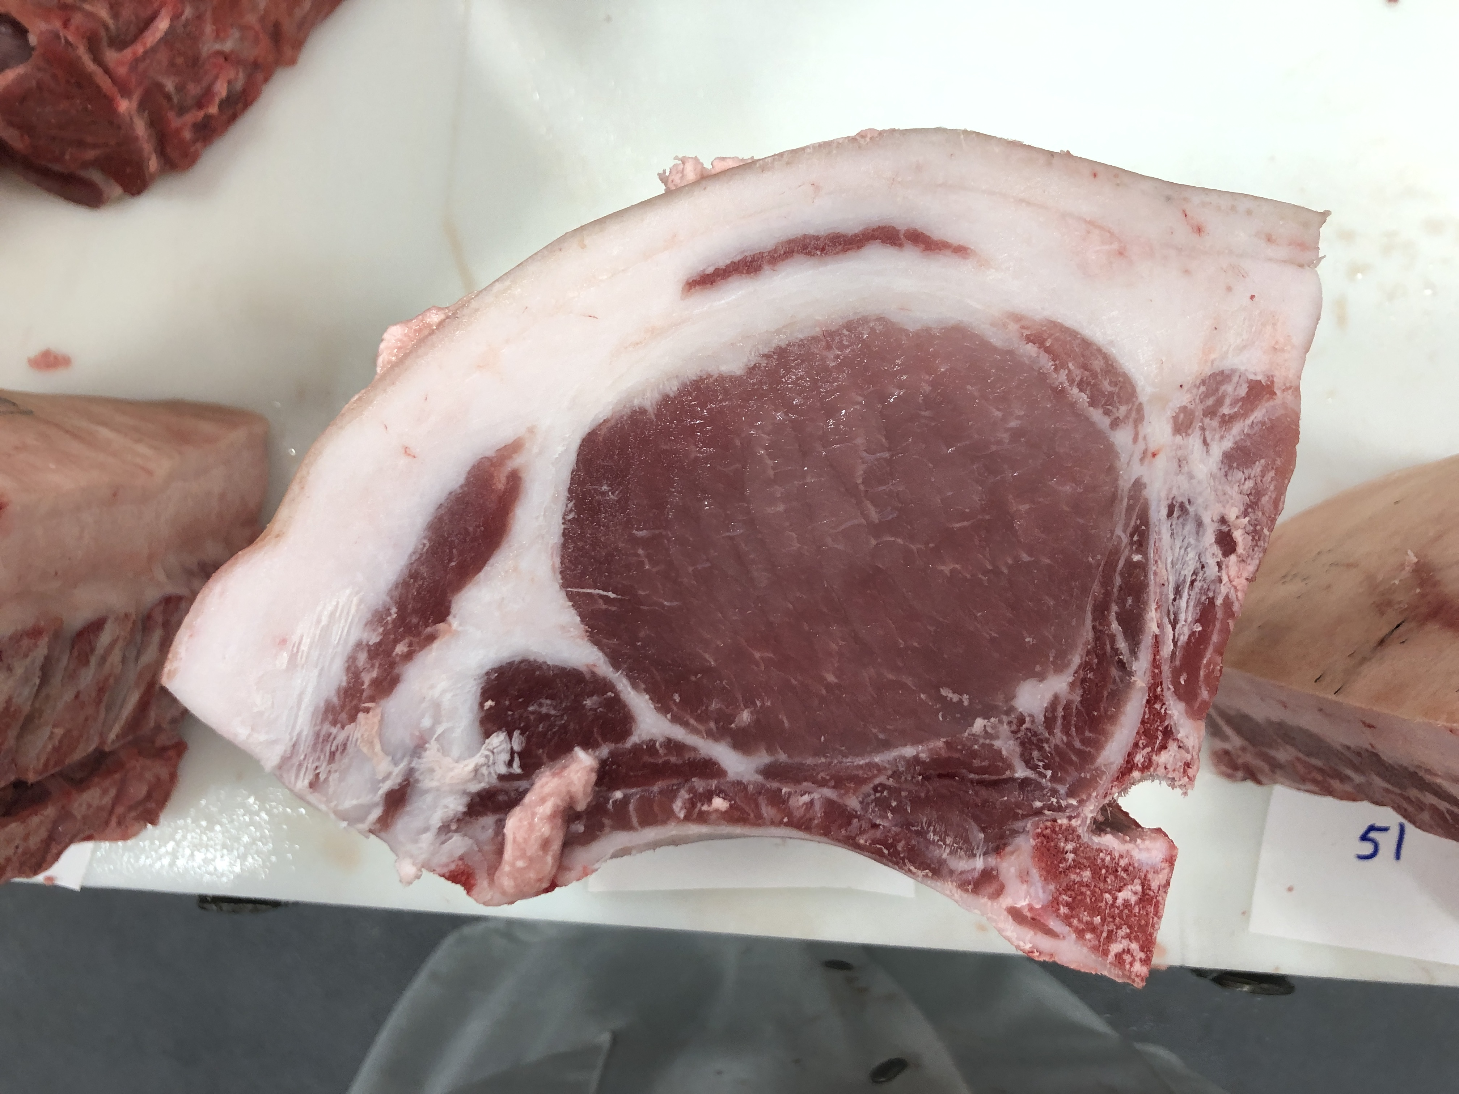
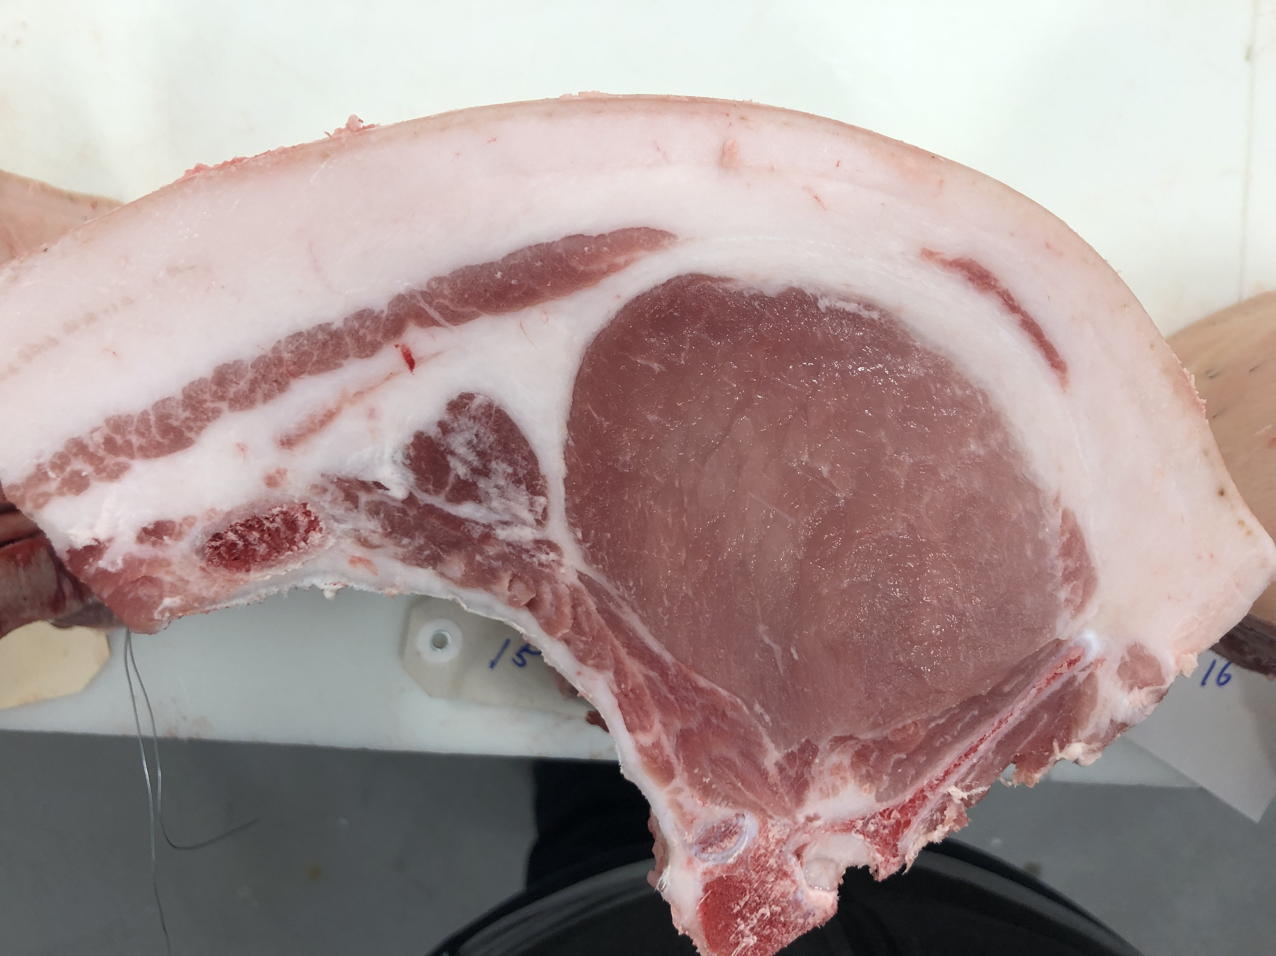
Pen 7: FKB9 TANGO ECHO XRAY 62-11 BY FLY’N BERKSHIRES
32
33
36
40
42
48
50

Slide 9







Pen 8: TSS9 VEGAN’S REVENGE 23-3 BY SEYBOLD BERKS
1
2
3
5
8
9
10

Slide 10








Pen 9: D&D9 Nutbush 1-5 BY DALLAS KUPER
1033
1034
1035
1041
1042
1043
1044
1045

Slide 11






Pen 10: MFC9 Jetblack 209-8 BY FLY’N K BERKSHIRES
13
14
20
26
32
40

Slide 12







Pen 11: MAP7 Old School 9-4 BY Tekippe Berkshires
311
313
314
315
316
317
318

Slide 13







Pen 12: AJC8 WARHORSE 7-2 BY AJC BERKSHIRES
1
2
3
4
5
6
7

Slide 14








Pen 13: FKBO TUG 94-5 BY FLY’N K BERKSHIRES
34
24
27
36
37
39
40
41

